Slide 1


Algorithm Analysis And Design final project
Efficient String Matching in Biological Sequences
Team Name: STARK

Slide 2


The Data Deluge
3 Billion Base Pairs. That is the scale of a single human genome. In this ocean of A, C, G, and T, finding a specific gene sequence is finding a needle in a digital haystack.
Traditional "brute-force" search methods falter at this magnitude. We need algorithms that don't just read faster—they need to be smarter.

Slide 3
Performance Gap
Naive Approaches
Optimized Solutions
The standard way to search checks every single character position. As datasets grow, the time required explodes.
By preprocessing the data or the pattern, we can skip vast sections of text, achieving sub-linear performance.
COMPLEXITY
COMPLEXITY
O(N × M)
O(N) / O(M)

Slide 4
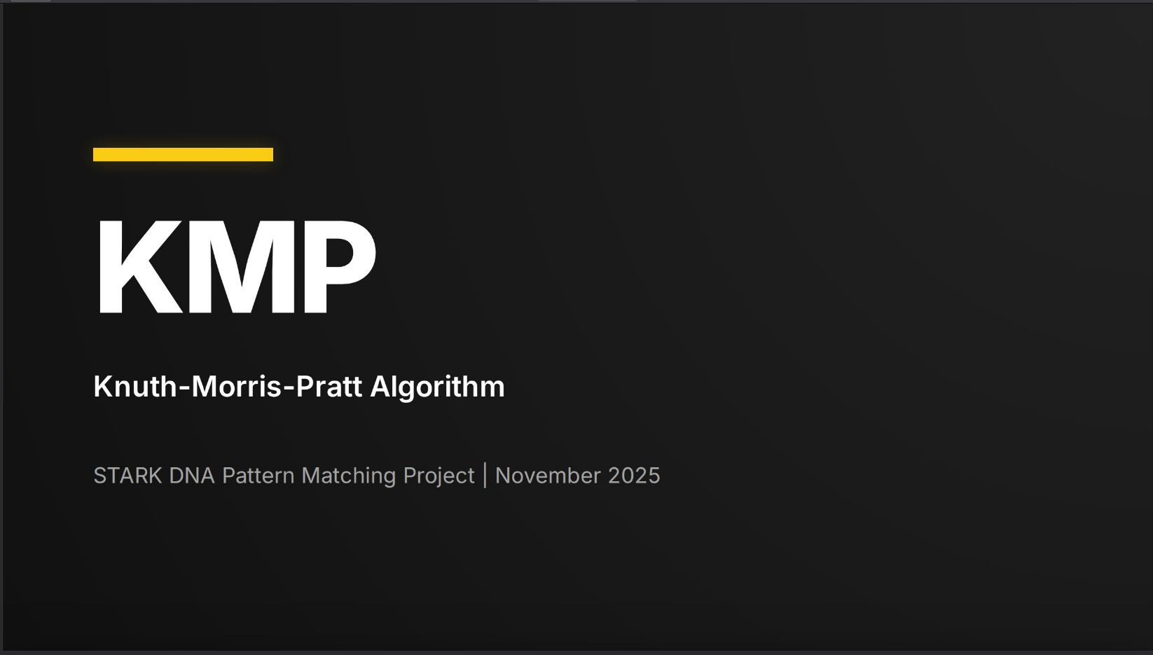

Slide 5
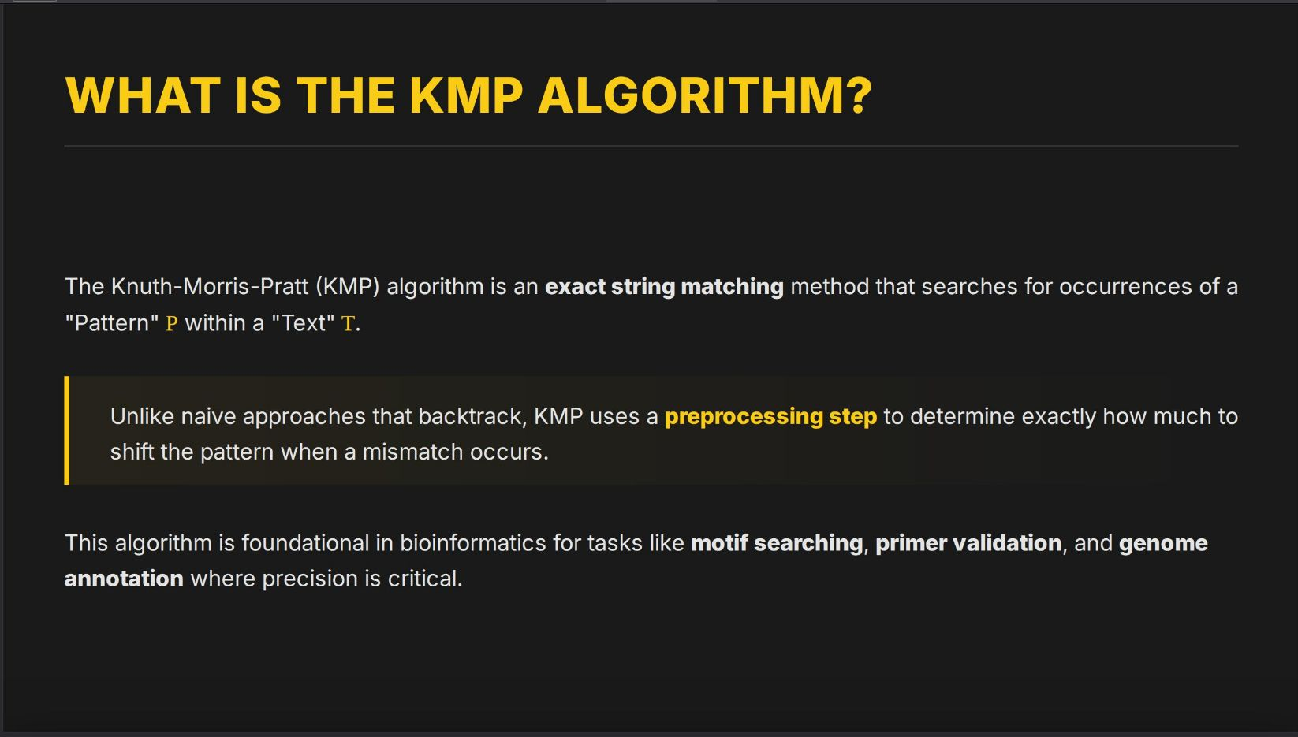
Basic presentation

Slide 6
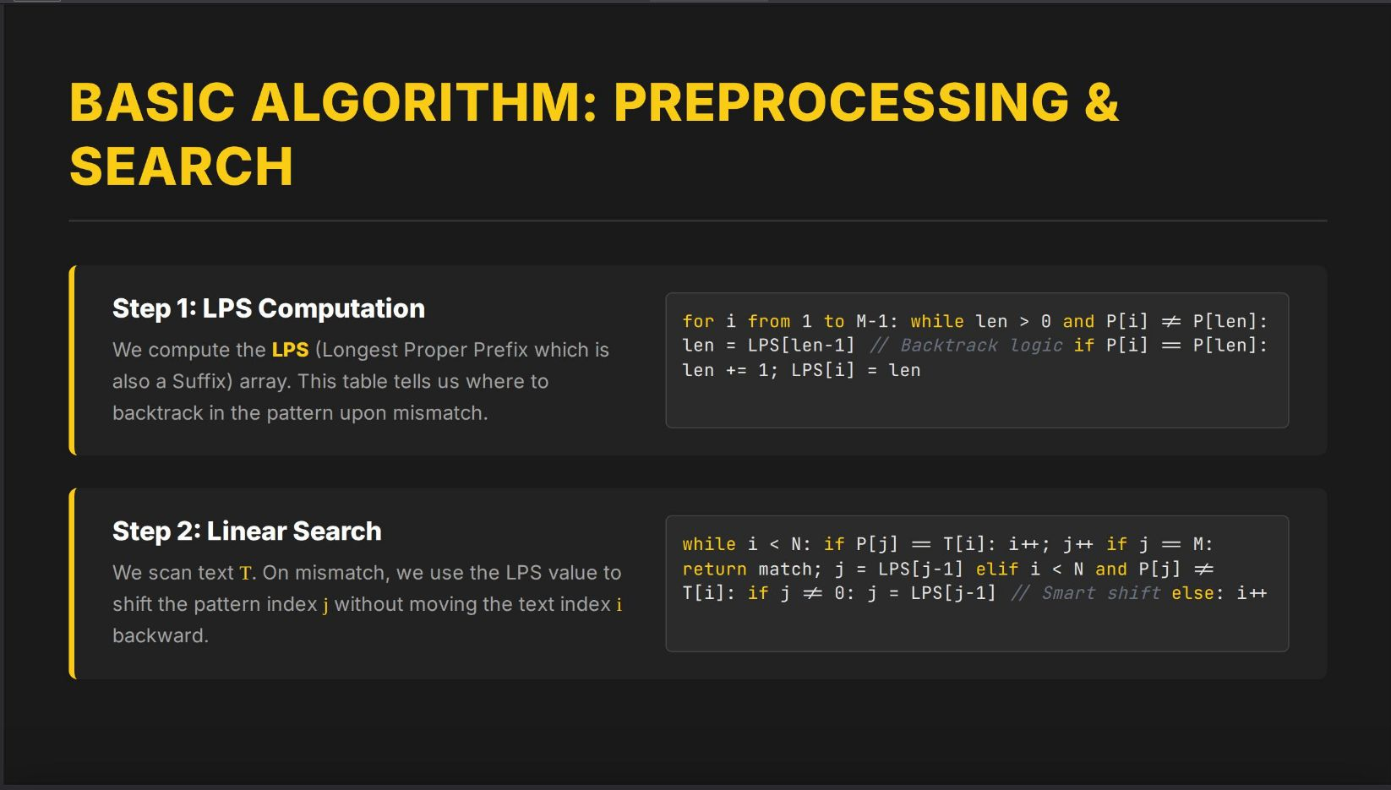
Agenda
Introduction
Building confidence
Engaging the audience
Visual aids
Final tips & takeaways

Slide 7
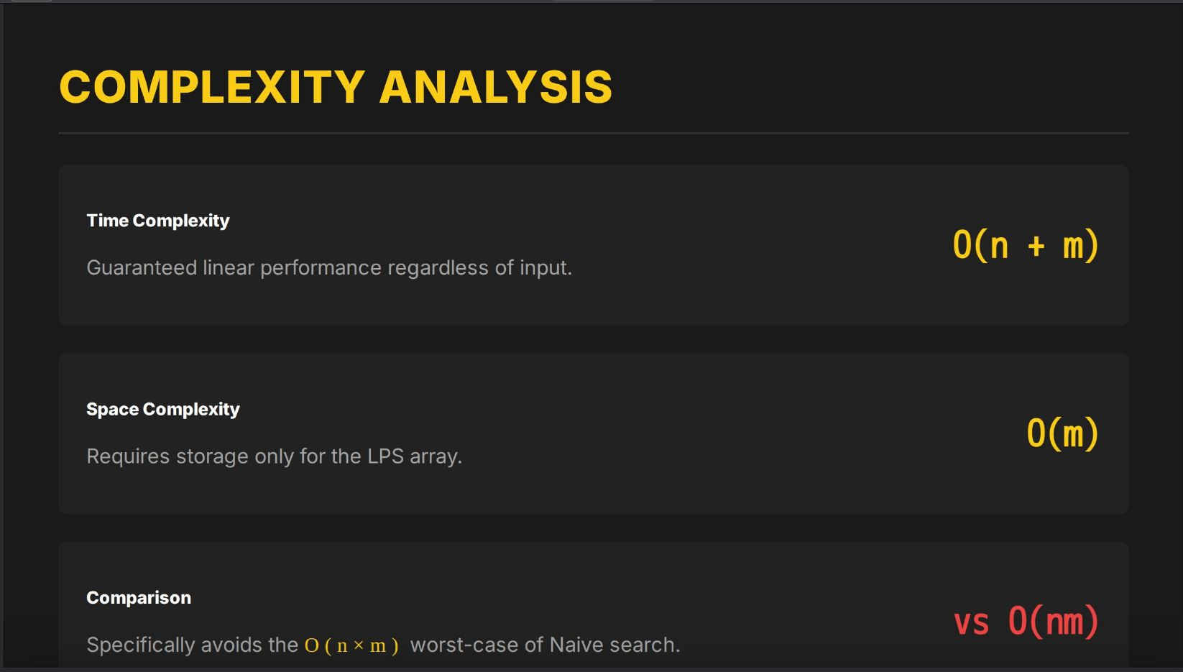

Power of communication

Slide 8
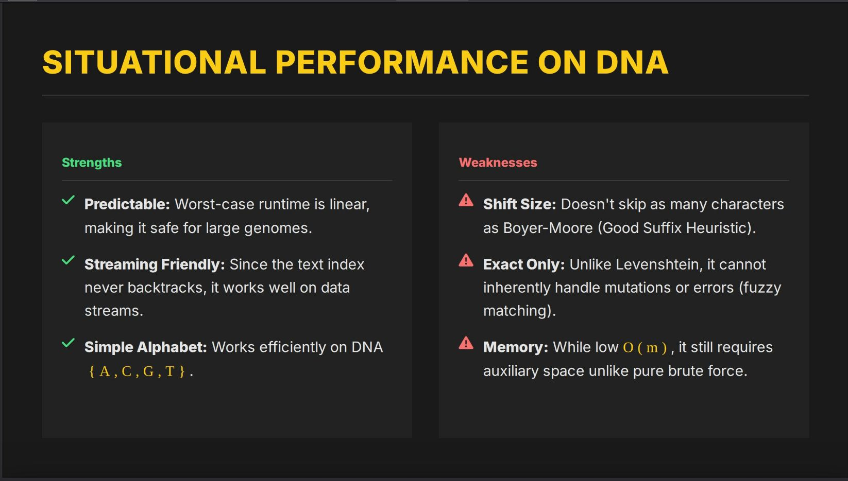
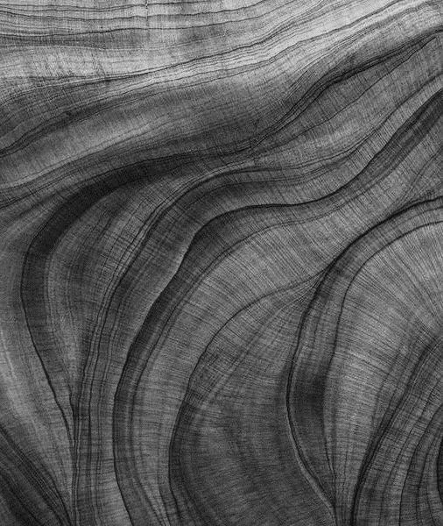
Overcoming nervousness
Confidence-building strategies

Slide 9
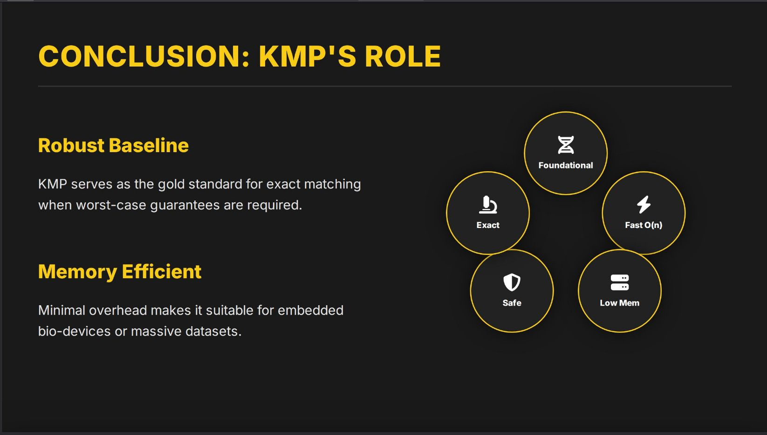
Engaging the audience
Make eye contact with your audience to create a sense of intimacy and involvement
Weave relatable stories into your presentation using narratives that make your message memorable and impactful
Encourage questions and provide thoughtful responses to enhance audience participation
Use live polls or surveys to gather audience opinions, promoting engagement and making sure the audience feel involved

Slide 10
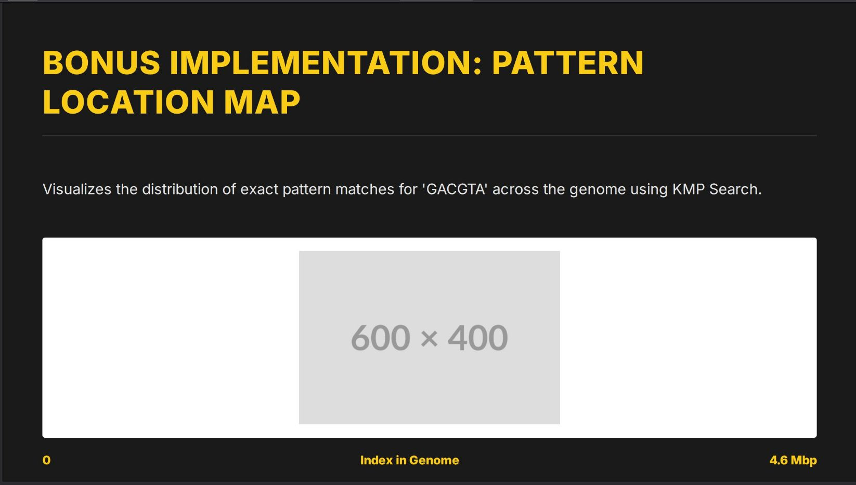
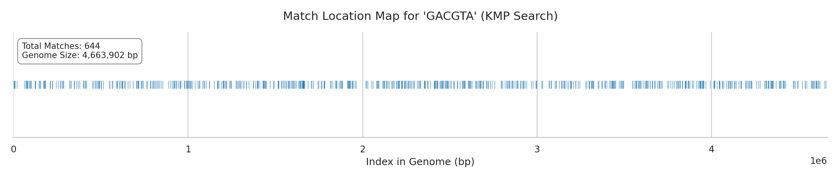
Selecting visual aids
Enhancing your presentation

Slide 11
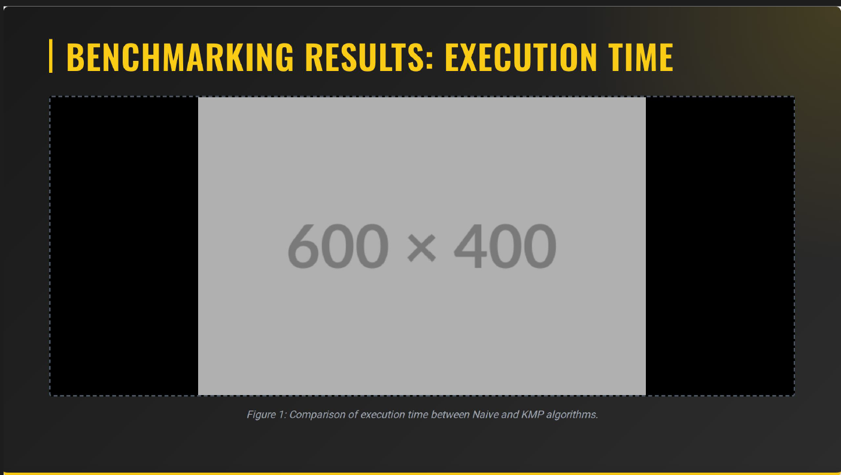
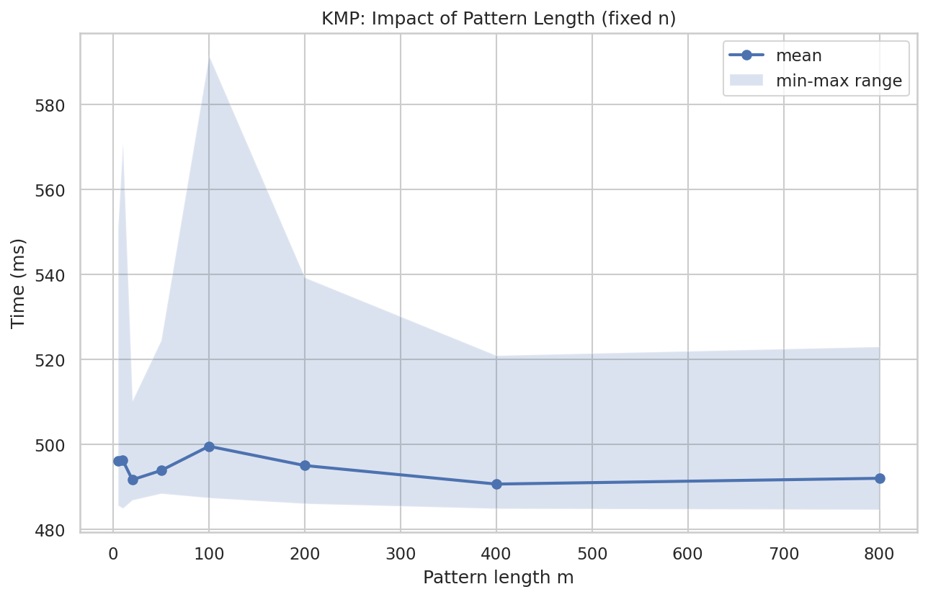
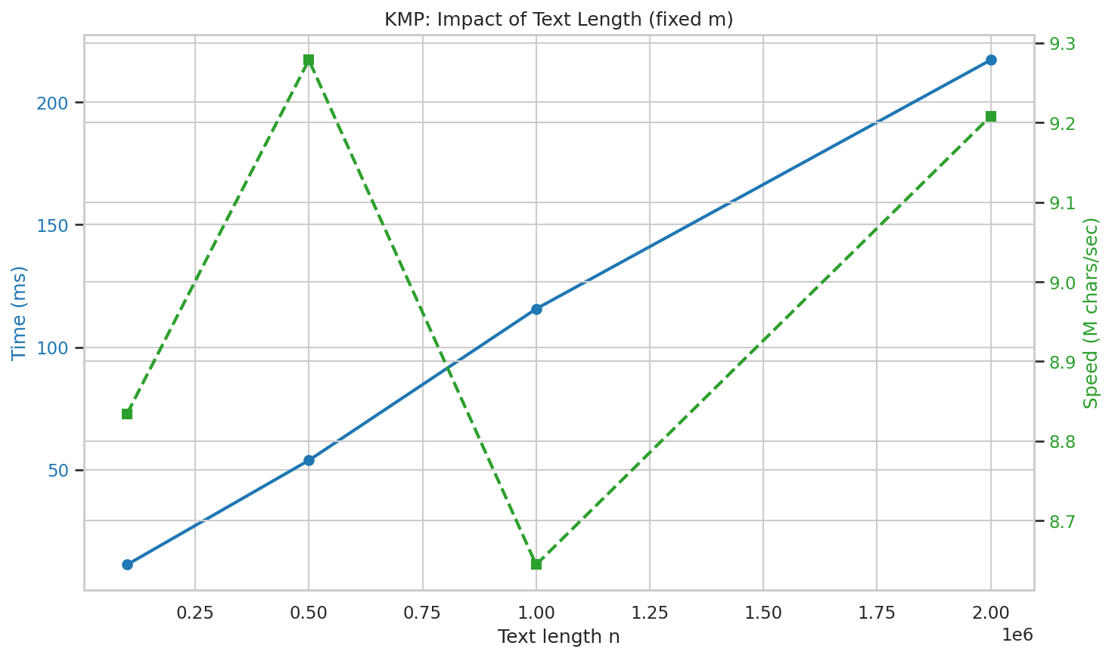

Slide 12
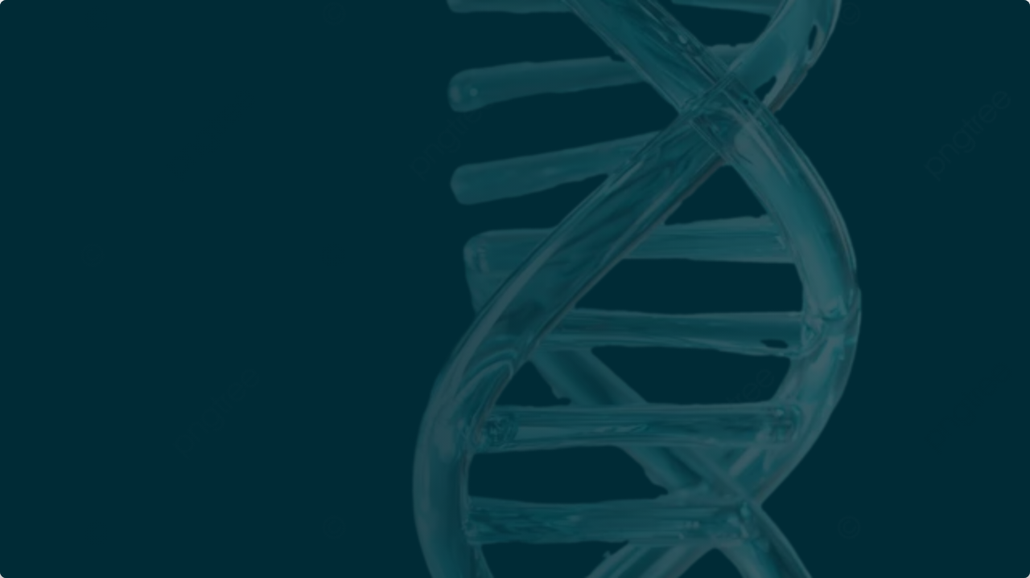
Boyer-Moore Algorithm
Analysis of Biological Sequences
Efficient String Matching for DNA

Slide 13

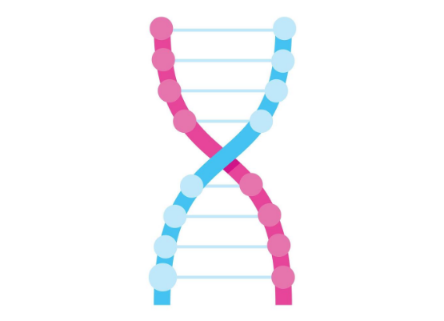
Introduction & Motivation
The Concept
The Boyer-Moore algorithm is a benchmark for practical string searching. Its key innovation is scanning the pattern from right to left while moving through the text from left to right.
Why DNA?
DNA sequences consist of a small alphabet: Σ = A C G T . This allows for frequent, large shifts, often achieving sub-linear time complexity.

Slide 14




The Two Heuristics
Bad Character Rule
Good Suffix Rule
Shift Logic
Aligns the mismatched character in the text with its rightmost occurrence in the pattern.
Aligns the matched suffix with an earlier occurrence of that suffix in the pattern.
At each step, the algorithm chooses the maximum shift: shift = max δ 1 δ 2

Slide 15
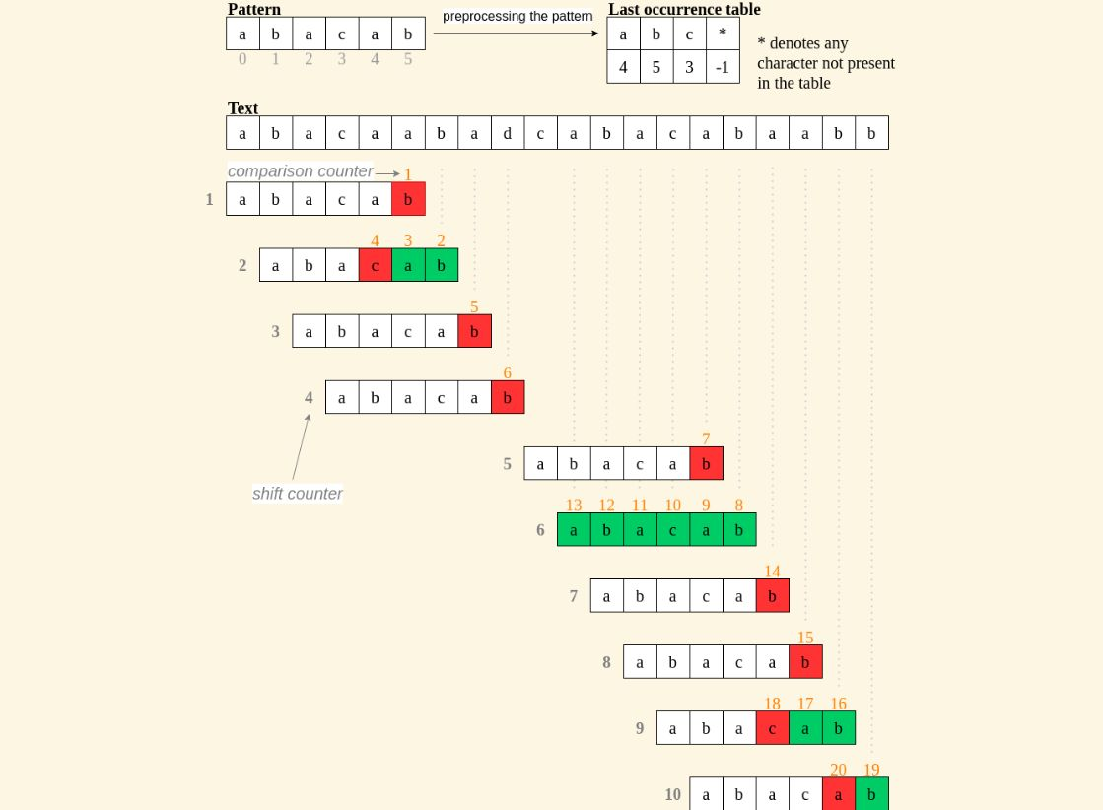

Bad Character Rule (δ1)
When a mismatch occurs at text character c:
•
If c exists in the pattern to the left: Shift pattern to align the rightmost occurrence of c with the mismatch.
•
If c does not exist: Shift the entire pattern past c.
Formula:
Where R[c] is the rightmost position of character c.

Slide 16
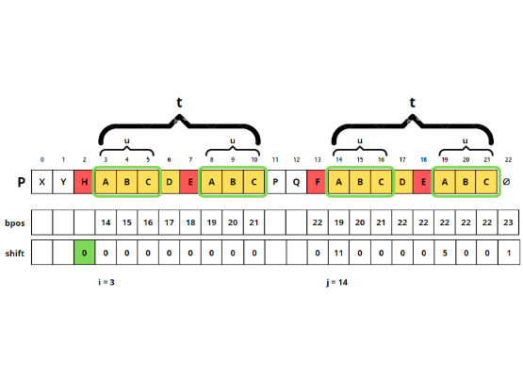
Good Suffix Rule (δ2)
Utilizes the suffix that has already matched (t).
•
Strong Suffix: Find another occurrence of t in the pattern, preceded by a different character than the one that caused the mismatch.
•
Prefix Match: If the full suffix doesn't repeat, find the longest prefix of the pattern that matches a suffix of t.
Crucial for DNA: Since the alphabet is small, bad character shifts are often small. The Good Suffix rule enables larger jumps.

Slide 17

Dry Run: Analysis
Pattern (P): GAATTC (EcoRI Site)
Text (T): ACGTACGGATGCGAATTCAGTACG

Slide 18


Dry Run - Alignment 1 (i=0)
Idx | 0 | 1 | 2 | 3 | 4 | 5 | 6 | ...
T | A | C | G | T | A | C | G | ...
P | G | A | A | T | T | C | - | ...
Status |  |  |  |  | Mismatch T vs A | Match
Calculation
Decision
Mismatch at P[4] ('T') vs T[4] ('A').
Shift = max(2, 6) = 6
Bad Char ('A'): 'A' is at index 2 in P. Shift = 4 - 2 = 2.
Good Suffix ('C'): No other 'C'. Shift = m = 6.

Slide 19

Dry Run - Alignment 3 (Match)
Skipping Alignment 2 (shifted by 6, resulted in mismatch). Moving to i=12.
Idx | ... | 12 | 13 | 14 | 15 | 16 | 17 | ...
T | ... | G | A | A | T | T | C | ...
P | ... | G | A | A | T | T | C | ...
Check | ... | 6 | 5 | 4 | 3 | 2 | 1 | ...
Full Match Found at Index 12!

Slide 20

Complexity Analysis
Best Case: O(n/m)
Worst Case: O(nm)
•
Occurs when the rightmost character of the pattern does not appear in the text at all.
•
Occurs with high periodicity (e.g., T="AAAA...", P="BAAA").
•
Algorithm shifts by full pattern length m.
•
Requires nearly m comparisons at each step.
•
Highly probable in DNA sequences due to random distribution of bases.
•
Extremely rare in biological data.

Slide 21


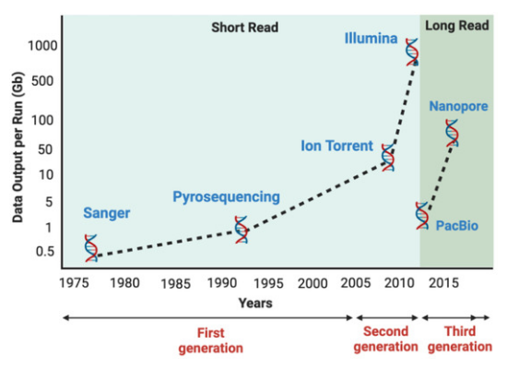
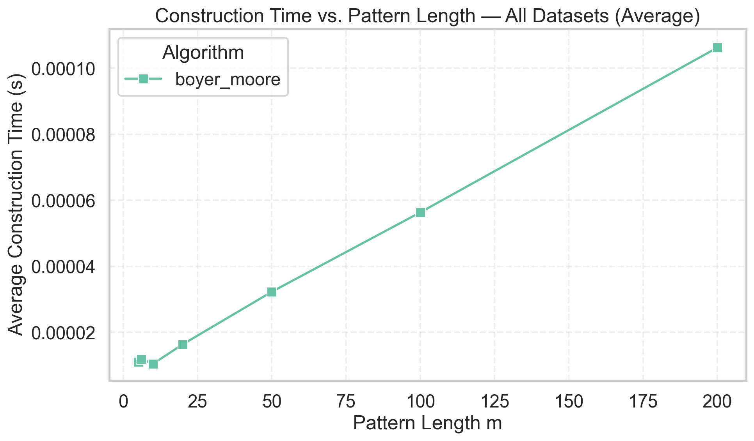
Impact of Alphabet Size
➤
Small Alphabet Challenge: For DNA ( alphabets = {A, C, G, T), the probability of character recurrence is high.
➤
Heuristic Balance: While the Bad Character rule is less effective due to frequent collisions, the Good Suffix rule becomes the primary driver of performance.
➤
Benchmarking: The graph demonstrates the construction time vs pattern lengths analysis. The time for construction increases linearly with pattern size.

Slide 22
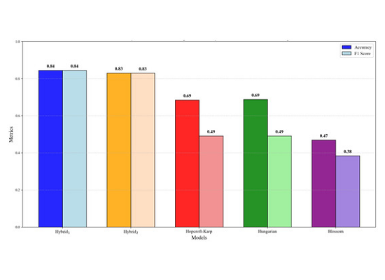
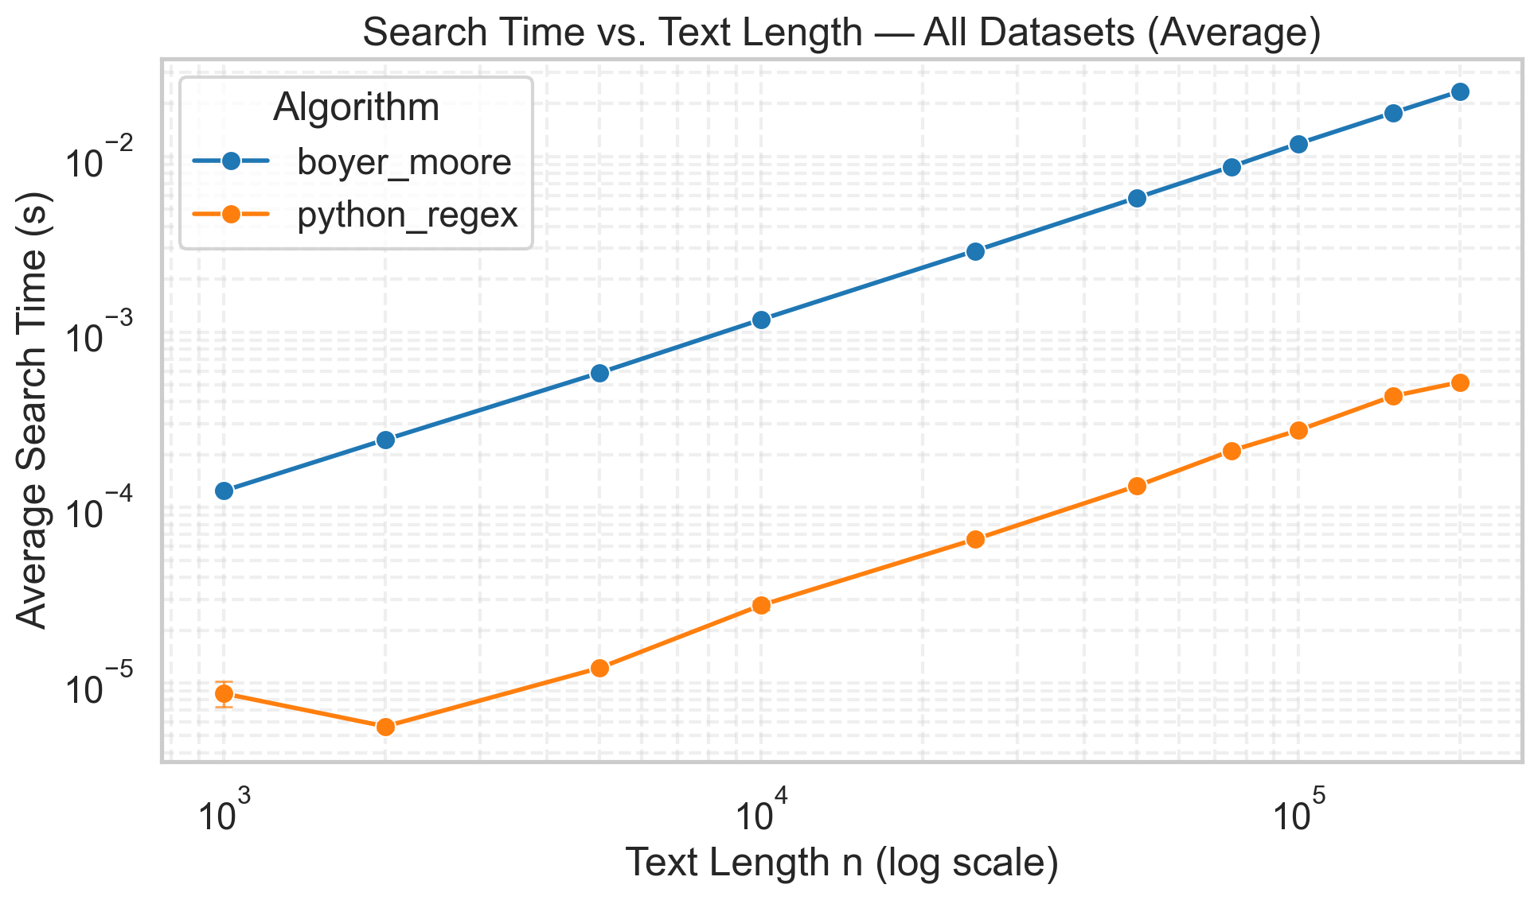
Search TIme vs. Text Size
➤
Comparisons per Character: In the best-case scenarios (common in large alphabets or specific DNA patterns), the ratio of comparisons to text length can be less than 1.
➤
Scalability: The algorithm scales efficiently for massive biological datasets (e.g., full genome sequencing).
➤
Data Insight: This graph shows the variation of search time with the text length, which is nearly linear.

Slide 23
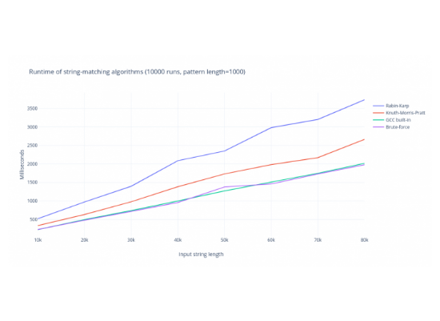
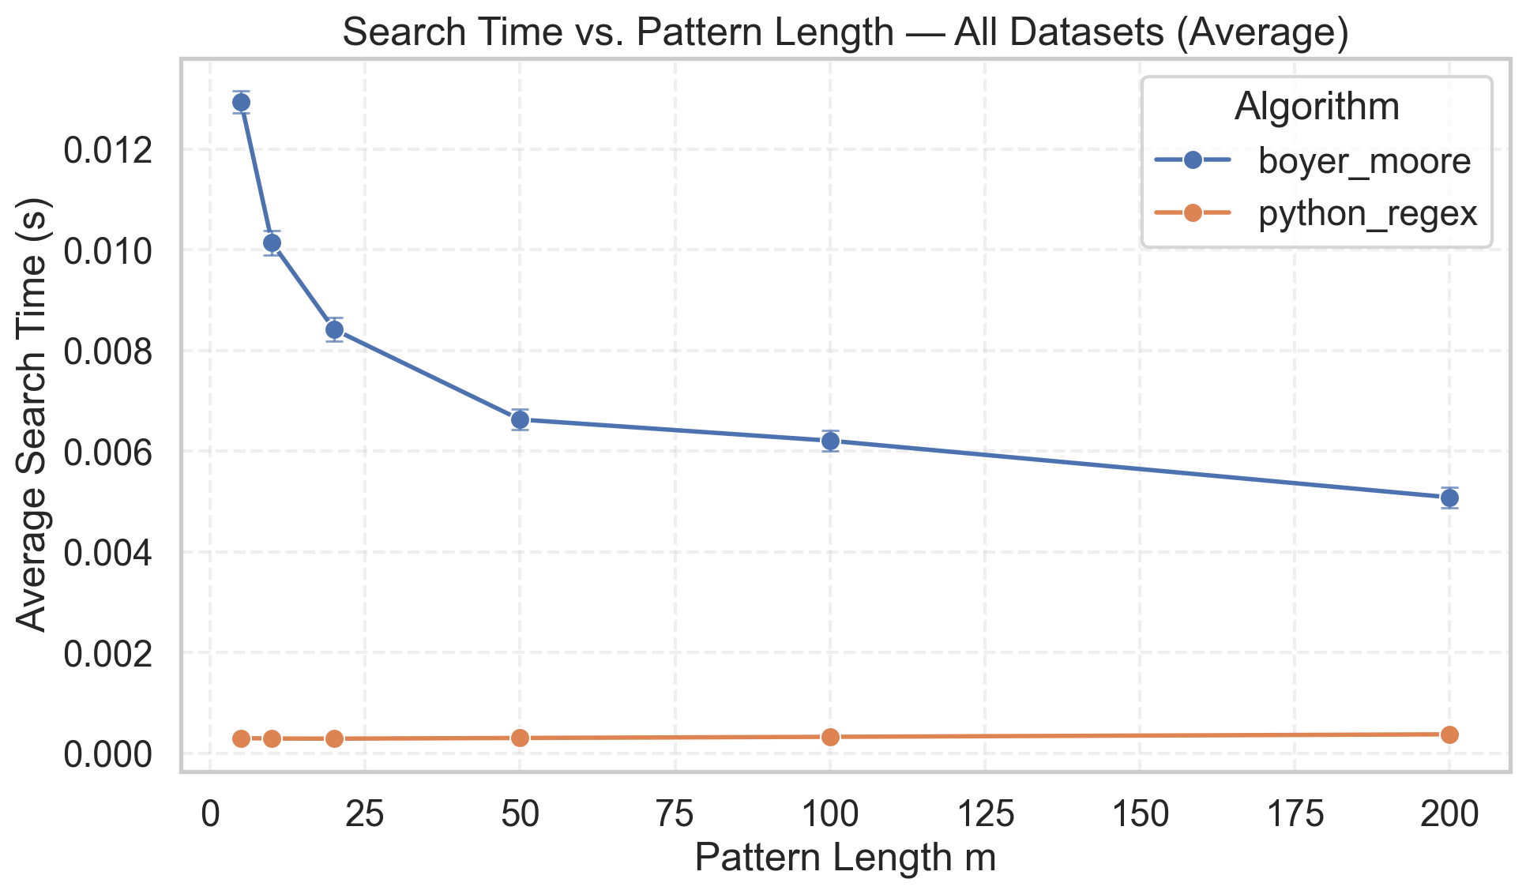
Performance vs. Pattern Length
➤
Sub-linear Behavior: Unlike naive algorithms, Boyer-Moore's efficiency often increases as the pattern length grows.
➤
Larger Shifts: Longer patterns provide more "information" to the Good Suffix heuristic, allowing for larger skips across the text.
➤
Visual Analysis: The graph illustrates the execution time dropping or stabilizing as m increases, a unique characteristic of this algorithm.

Slide 24
Implementation Details
Overlapping Matches: After finding a match, the algorithm must shift by one unit to ensure no overlapping occurrences are missed.
Alphabet Normalization: Input must be normalized (e.g., uppercase) and ambiguous bases ('N') handled as wildcards or mismatches.
Preprocessing Cost: O (m + Σ). Negligible for long texts.
Future Work: An arbitrary number of mismatches may be allowed using a dynamic program approach and the analysis of this variation could be done deeply.

Slide 25
Analysis of Suffix Trees and Suffix Arrays
Tanush Garg

Slide 26
Suffix Array (Concept)
Definition: A sorted array of all suffixes of a string.
Structure: Stores integers representing the starting index of each suffix.
Example ("banana"):
List suffixes: banana, anana, nana, ana, na, a.
Sort them: a, ana, anana, banana, na, nana.
Store indices: [5, 3, 1, 0, 4, 2].
Space Complexity: O(n) integers (Very space-efficient).

Slide 27
Dry Run - Naive Construction
Input String: banana$ (n=7)
Step 1: Extract All Suffixes
i=0: banana$
i=1: anana$
i=2: nana$
...
i=6: $
Step 2: Standard Sort
We compare string vs string.
Comparison 1: anana$ vs ana$ -> match 'a', 'n', 'a'... mismatch at 4th char.
The Bottleneck:
Comparing two long suffixes can take O(n) time.
Sorting n items takes O(nlog n) comparisons.
Total Time: O(n^2log n).
Visual: For a Human Genome (n=3 billion), this would take years.

Slide 28
Dry Run - Manber-Myers (Prefix Doubling)
Key Insight: Don't compare full strings. Sort by the first 2^k characters only.
Round 0 (k=0, Length 1):
Sort by single characters: b, a, n, a, n, a, $.
Ranks assigned: $=0, a=1, b=2, n=3.
Round 1 (k=1, Length 2):
We don't look at characters anymore. We look at Rank Pairs.
To sort index i, we look at (Rank[i], Rank[i+1]).
Example: Differentiating the two as at index 1 and 3.
Index 1 (an): Pair is (1, 3) (Rank of 'a', Rank of 'n')
Index 3 (an): Pair is (1, 3) (Rank of 'a', Rank of 'n') -> Still identical!
Round 2 (k=2, Length 4):
Sort using pair (Rank[i], Rank[i+2]).
Example: Now we compare anana vs ana$.
Index 1 (anan): Pair is (Rank of 'an', Rank of 'an')
Index 3 (ana$): Pair is (Rank of 'an', Rank of 'a$')
Since Rank('an') > Rank('a$'), index 3 comes first.
Result: Unique ranks achieved. Array is sorted in O(nlog n).

Slide 29
Suffix Tree (Concept)
Definition: A compressed Trie containing all suffixes of the text.
Key Properties:
Each edge is labeled with a substring.
Each path from root to leaf represents a unique suffix.
Internal nodes have at least 2 children.
Advantage: Extremely fast search and structural visualization of string properties.
Disadvantage: High memory consumption due to node pointers.

Slide 30
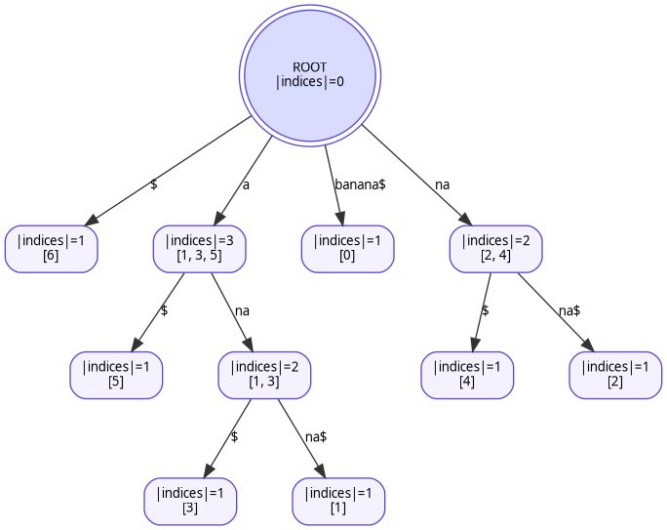
Dry Run - Naive Suffix Tree Construction
Method: Insert every suffix of banana$, one by one, always starting from the Root.
Step 1: Insert banana$ -> New edge created.
Step 2: Insert anana$ -> New edge created.
Step 3: Insert nana$ -> New edge created.
The Inefficiency (Step 4 - Inserting ana$):
Start at Root.
Traverse edge a (Match found).
Traverse edge na (Match found).
Insert $ at the end.
Critique: We walked down the path a-n-a which we had already visited. In a genome with millions of repeats, these redundant traversals cause O(n^2) complexity.

Slide 31
Dry Run - Ukkonen’s Algorithm (The Rules)
Difference: We process the string from Left to Right (Prefixes), not Suffixes.
The "Active Point": We never restart from the root. We stay at the current node.
The 3 Extension Rules:
Rule 1 (Leaf Extension): If the path ends at a leaf, just add the new character to the edge. (Cost: Free).
Rule 2 (The Split): If the path ends in the middle of an edge and the next character doesn't match, Split the edge and create a new branch.
Rule 3 (The Showstopper): If the character we want to add already exists next on the path, Do Nothing. Just note the position (Active Point) and move to the next step.

Slide 32
Dry Run - Ukkonen’s Algorithm (Suffix Links)
Scenario: We just performed a Split at an internal node (e.g., node A).
The Problem: We need to perform the same split for the next suffix.
Naive way: Go back to root, find the path, split again.
Ukkonen's way: Use a Suffix Link.
The Mechanism:
Every internal node has a pointer (dashed line) to another node representing its suffix.
Example: If Node A represents path nan, it has a link to Node B representing an.
Result: We teleport from Node A ->Node B in O(1) time, skipping the root traversal entirely. This keeps the total time O(n).

Slide 33
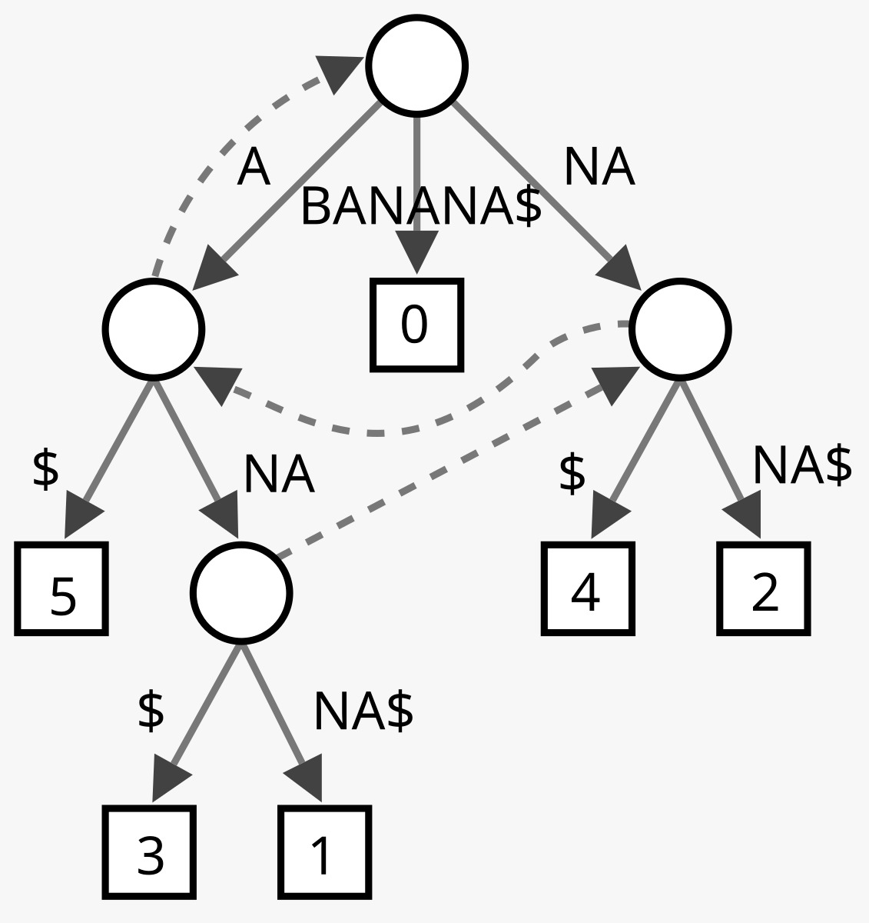
Dry Run - Ukkonen’s Algorithm

Slide 34
Search Logic
Searching in Suffix Array:
Suffixes are sorted, so we use Binary Search.
Perform two binary searches to find the first and last occurrence.
Time: O(mlog n).
Searching in Suffix Tree:
Traverse down the tree matching characters of the pattern P on the edges.
If traversal completes, the pattern exists.
Time: O(m) (Depends only on pattern length!).

Slide 35
Dry Run - Querying Suffix Array
Context:
Text: banana$
Suffix Array: [6, 5, 3, 1, 0, 4, 2]
Corresponding Suffixes: $, a$, ana$, anana$, banana$, na$, nana$
Objective: Find all occurrences of "ana".
Step 1: Lower Bound Binary Search (Find first match)
Check Middle (Index 3): anana$ matches "ana". Record as potential match, look Left.
Check Left (Index 1): a$ is smaller than "ana". Look Right.
Result: Index 2 (ana$).
Step 2: Upper Bound Binary Search (Find where matches end)
Check Right side...
Find the first suffix strictly greater than "ana".
Result: Index 4 (banana$).
Step 3: Output
All indices between 2 and 4 (exclusive of 4) are matches.
Indices: 2, 3.
Map back to original positions: 3 (ana$), 1 (anana$).

Slide 36
Dry Run - Querying Suffix Tree
Context:
Text: banana$
Pattern: "nana"
Step 1: Start at Root
Check outgoing edges for character n.
Match: Edge labeled na.
Traverse: Consume na. Remaining pattern: na.
Step 2: At Internal Node
Check outgoing edges for character n.
Match: Edge labeled na$.
Traverse: Consume na. Remaining pattern: Empty.
Step 3: Result
Pattern is fully consumed.
Count leaves in the subtree below this node.
Leaf Index: 2 (Starting position of nana).
Verdict: Comparison count = 4 (Length of pattern). Text size (N=7) was irrelevant.

Slide 37
Theoretical Complexity Comparison
Feature | Suffix Array (Manber-Myers) | Suffix Tree (Ukkonen) | Winner
Construction Time | O(nlog n) | O(n) | Suffix Tree
Search Time | O(mlog n) | O(m) | Suffix Tree
Space Complexity | O(n) (Low Constant) | O(n) (High Constant) | Suffix Array
Memory Locality | Contiguous (Cache Friendly) | Pointer-based (Cache Misses) | Suffix Array
Implementation | Moderate (Sorting logic) | Difficult (Complex edge cases) | Suffix Array
Speed vs. Space: Suffix Trees are theoretically faster for querying but consume 10x-20x more memory.
The "Hidden Constant": While both are O(n) in space, a Suffix Array stores 1 integer per character (4 bytes), while a Suffix Tree node stores children pointers, indices, and suffix links (~40+ bytes).

Slide 38
Analysis Infrastructure
Synthetic Data Generation:
Script: generate_dna(length)
Logic: Generates random DNA sequences (A, C, G, T) of varying lengths (N = 1,000 to 200,000).
Purpose: Ensures algorithms are tested against worst-case entropy (random noise) rather than just repetitive English text.
Benchmarking Engine:
Metric: Wall-clock time (using time.perf_counter()).
Process:
Instantiate SuffixTree and SuffixArray classes.
Measure Construction Time (Build time).
Measure Query Time (Time to find a fixed set of 100 patterns).
Run 5 iterations per length and average results to remove noise.
Visualization (Matplotlib):
Log-Log Plots: Used for Construction Time to distinguish between O(N) and O(Nlog N) slopes.
Linear Plots: Used for Memory and Query time comparisons.
Correctness Check: The script asserts Tree.count(P) == Array.count(P) before adding the data point to the graph.

Slide 39
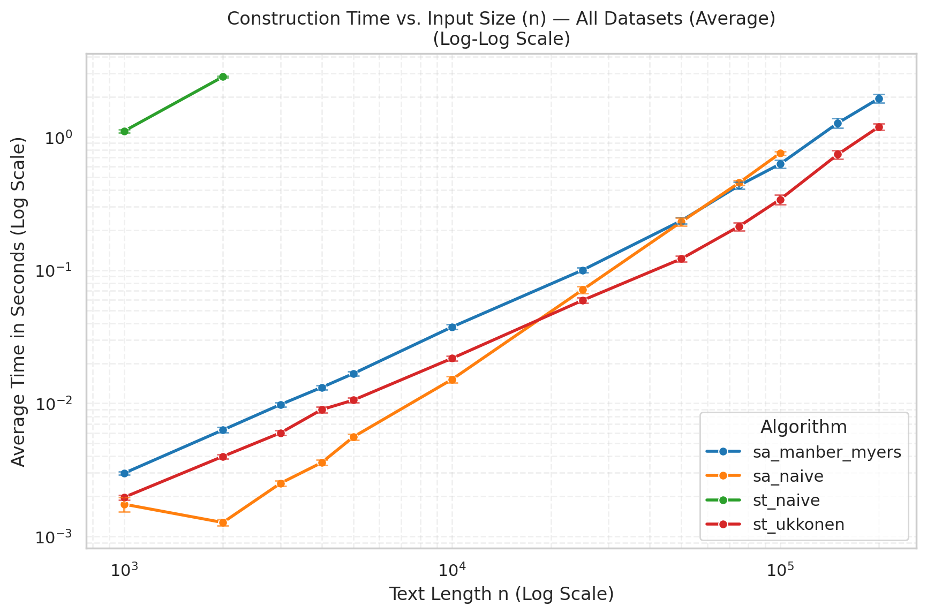
Construction Time
The Axes (Log-Log Scale):
X-Axis: Length of the DNA sequence (N) ranging from 1,000 to 200,000 bases.
Y-Axis: Time taken in seconds.
Note: On a Log-Log plot, a straight line indicates a polynomial relationship. A slope of 1 means O(N), a slope of 2 means O(N^2).
The "Naive" Failures (Steep Slopes):
Green Line (st_naive): The Naive Suffix Tree is the slowest. It rises vertically and crashes/times out after just N=2,000. This confirms the theoretical O(N^2) bottleneck.
Orange Line (sa_naive): The Naive Suffix Array starts fast but degrades rapidly. The steep slope (approx 2) confirms quadratic complexity. It becomes unusable for datasets larger than 10^4.
The "Optimized" Winners (Flat Slopes):
Blue Line (sa_manber_myers): Shows stable performance. It grows slowly, consistent with its O(NlogN) complexity. It handles $200,000$ characters in approx 1 second.
Red Line (st_ukkonen): The fastest performer. The line is nearly parallel to the O(N) slope, empirically proving Linear Time complexity.

Slide 40
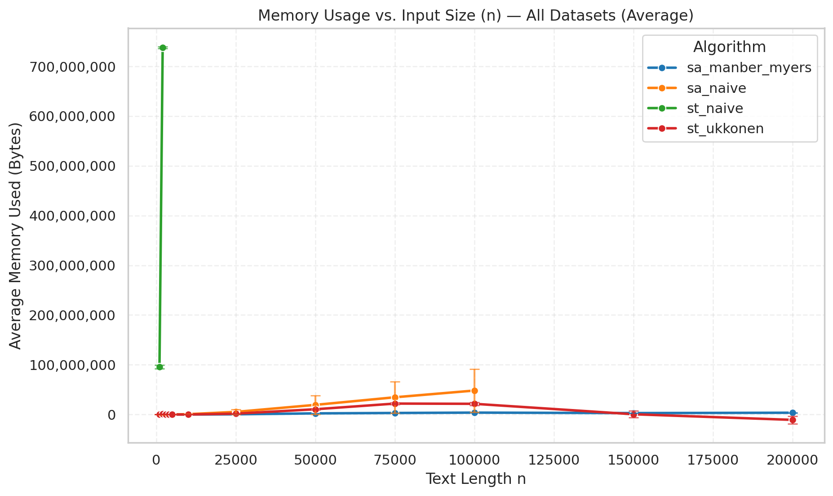
Memory Usage
The "Green Spike" (Naive Suffix Tree):
Observation: The green line shoots vertically to ~750 MB of RAM for a tiny input of just N=2,500 characters.
Cause: The naive implementation creates thousands of Python objects (Nodes) and dictionaries for every edge. This overhead is catastrophic. It demonstrates why raw O(N^2) space is unusable.
The Scale Distortion:
Because the Naive Tree (Green) uses so much memory, it "squashes" the other lines to the bottom of the chart. This visualizes the massive difference in constant factors.
Optimized Structures (Red vs. Blue):
Red Line (Ukkonen): Efficient O(N) space, but still uses significantly more memory than the array due to storing Node objects and Suffix Links.
Blue Line (Suffix Array): The absolute winner. It hugs the X-axis (y approx 0).
Why: A Suffix Array is just a contiguous block of integers. For N=200,000, it takes only a few Megabytes, whereas the Tree requires complex pointer structures.

Slide 41
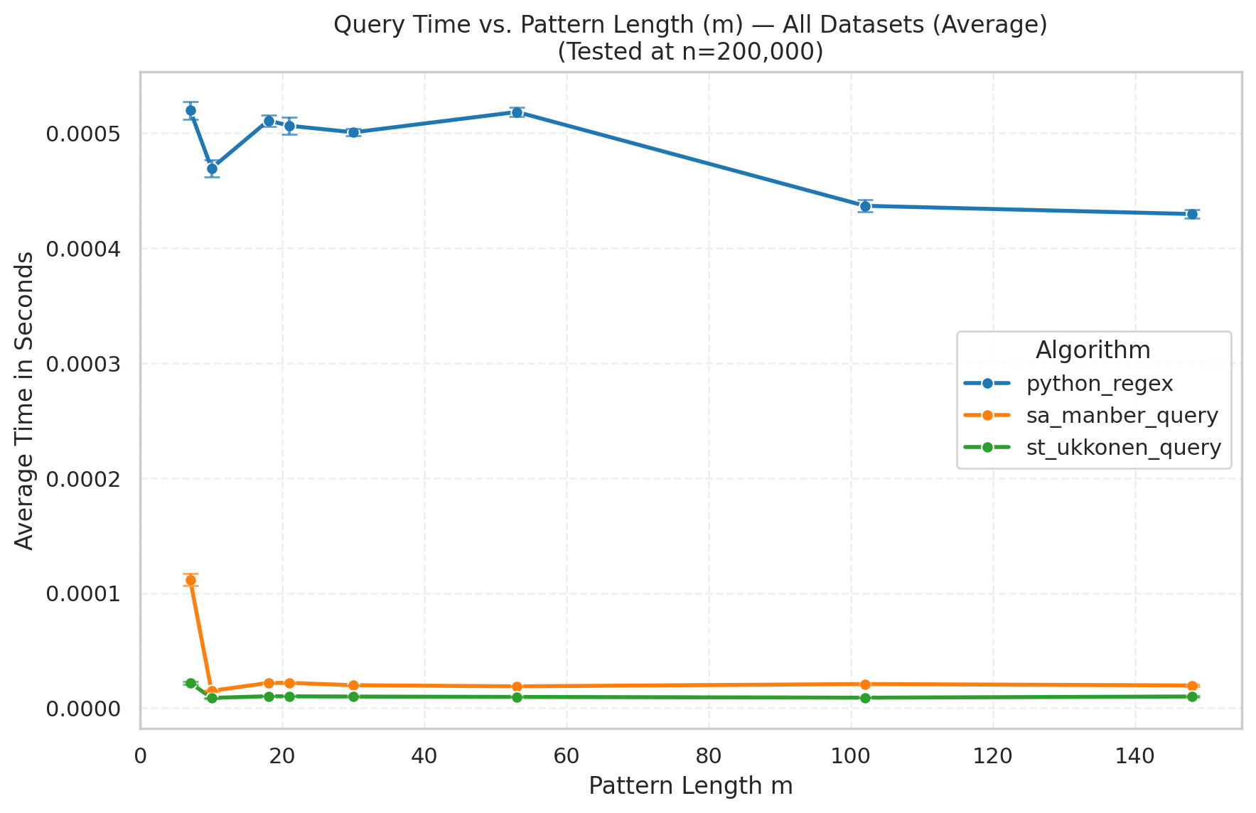
Query Time
The Baseline (Python Regex - Blue Line):
Consistently slower, hovering around 0.5 milliseconds (0.0005s).
Regex typically scans the text linearly O(n), so even for short patterns, it has to process the genome.
Suffix Structures (Orange & Green Lines):
Both appear as flat lines near zero. They are approximately 20x to 50x faster than regex.
Suffix Tree (Green): The fastest method. Search time is O(m), depending only on the pattern length, not the genome size.
Suffix Array (Orange): Extremely fast, slightly above the tree. Search time is O(mlogn) due to binary search overhead.
Scalability:
Notice that as the pattern length (m) increases (x-axis), the Suffix Structures remain virtually instantaneous. This confirms that query performance is decoupled from the massive text size.

Slide 42

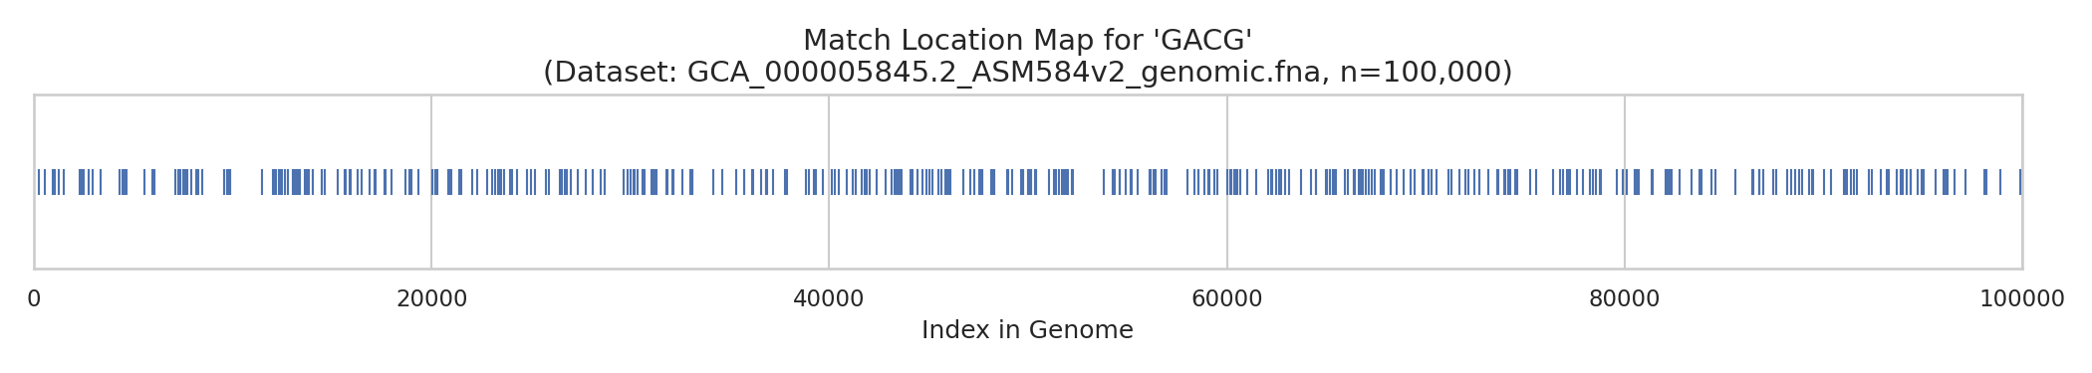
Visualization & Analysis Tools (BONUS)
Match Location Mapping
Function: Plots search hits across the genome (N=100k) for patterns like "GACG".
Insight: Instantly reveals if gene motifs are clustered in specific regions or distributed evenly.
Automated Suffix Tree Rendering
Function: Uses Graphviz to generate structural diagrams directly from the data structure.
Insight: Verifies correctness by visualizing path compression (merged edges) and leaf indices.

Slide 43
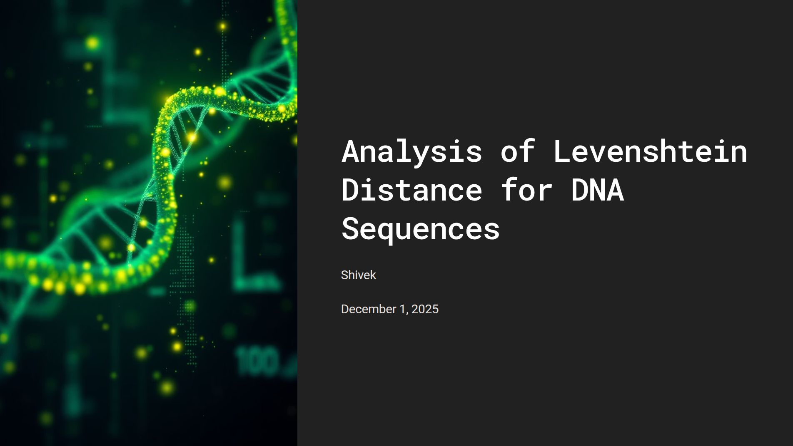

Slide 44
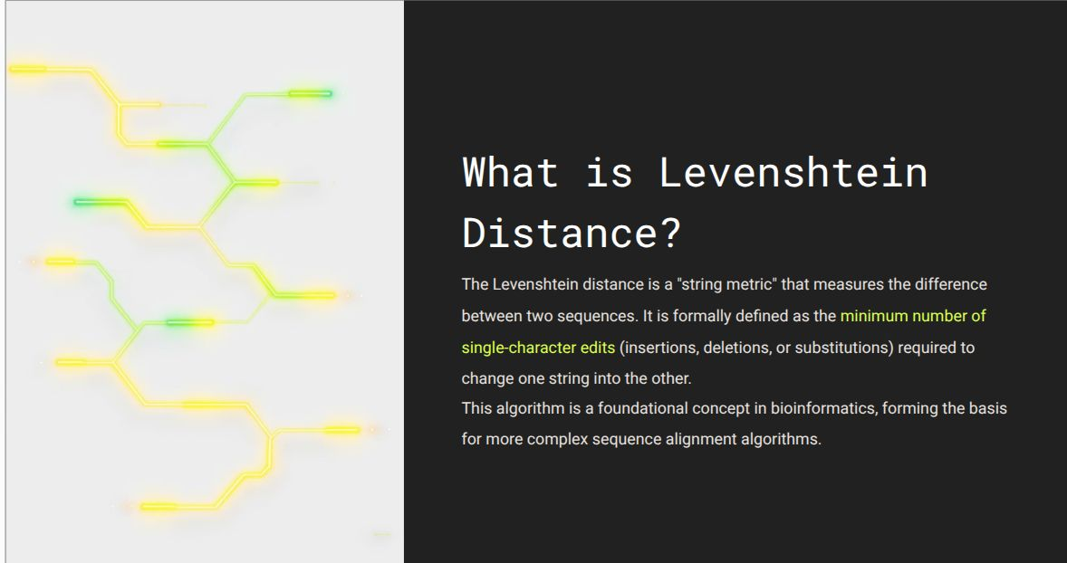
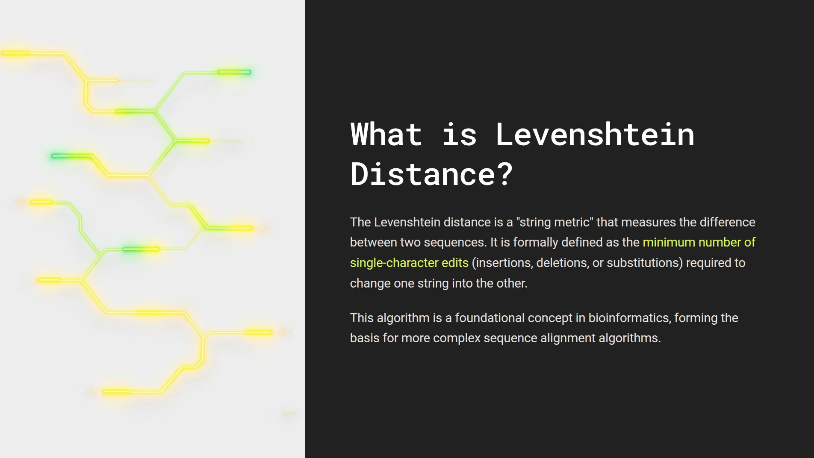

Slide 45
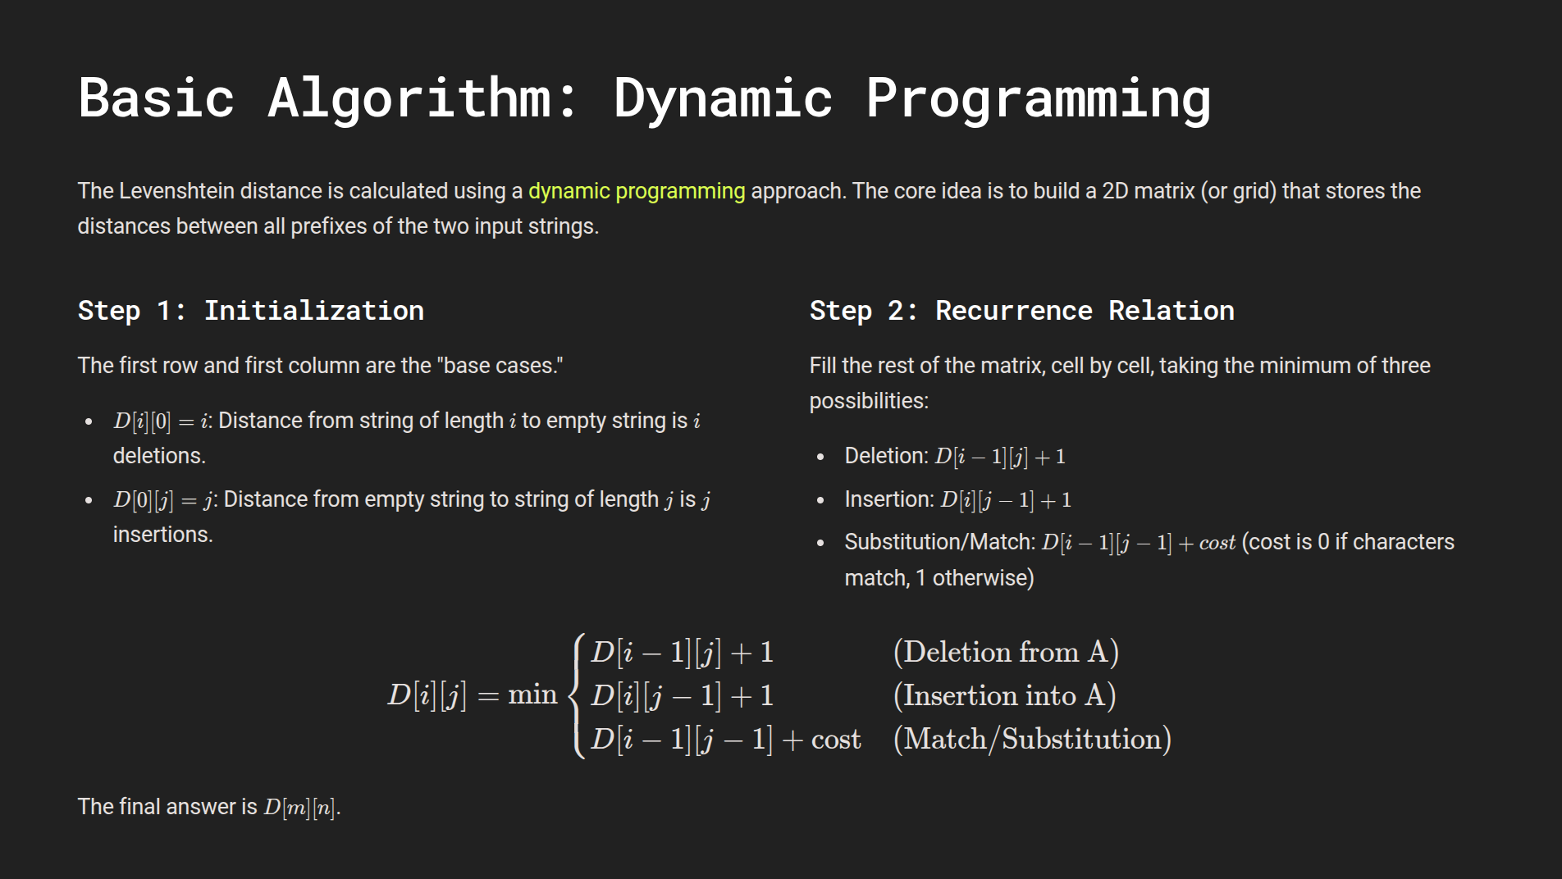

Slide 46
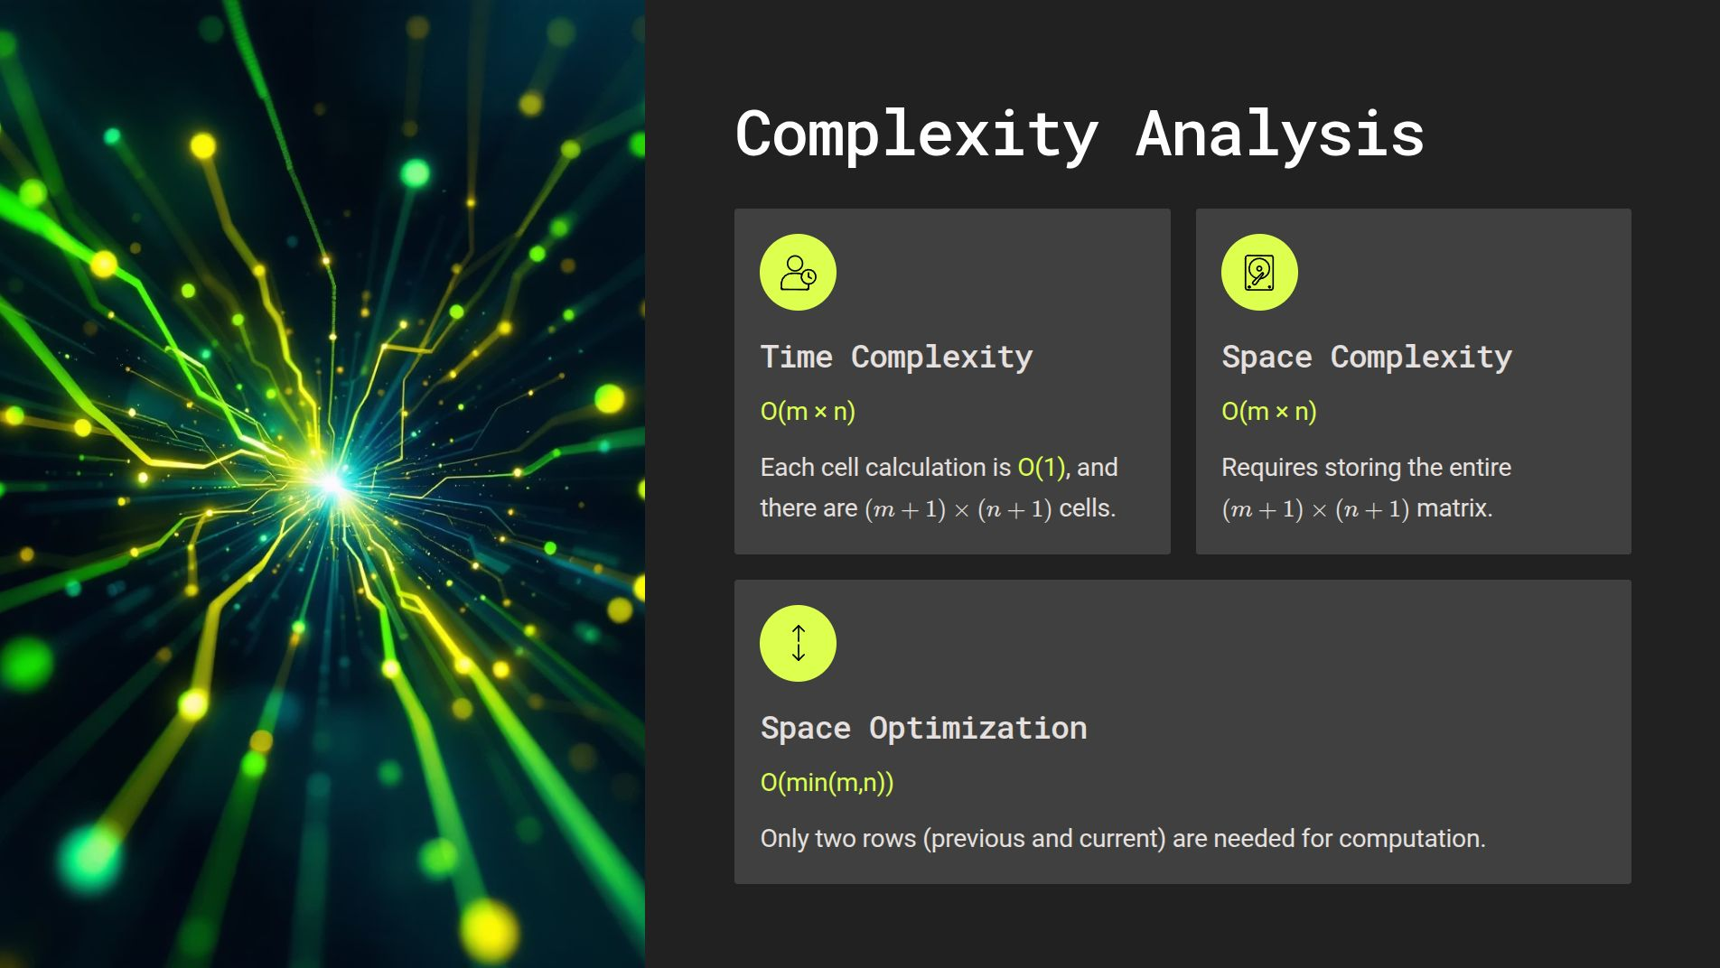

Slide 47
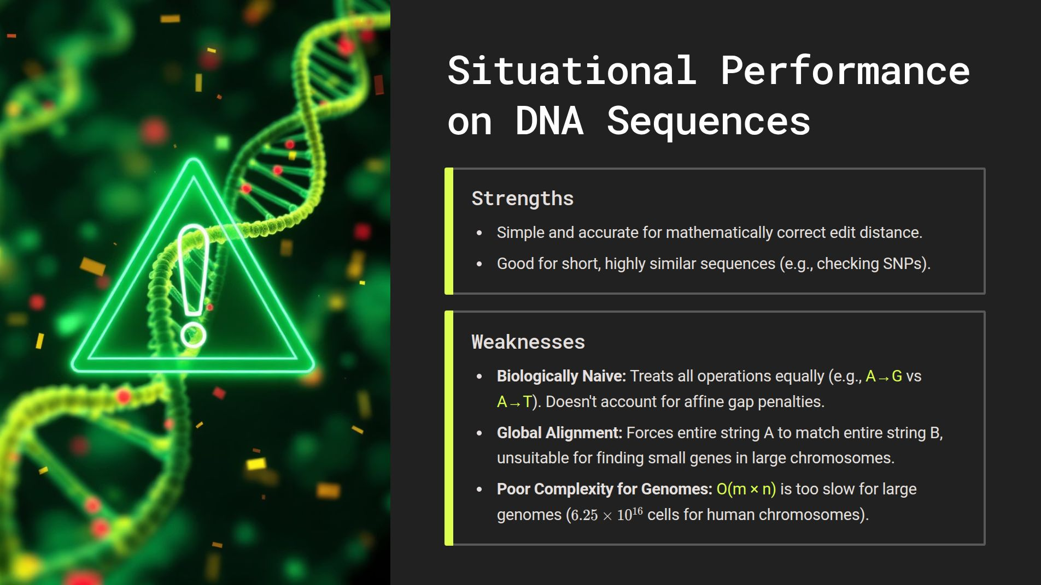

Slide 48
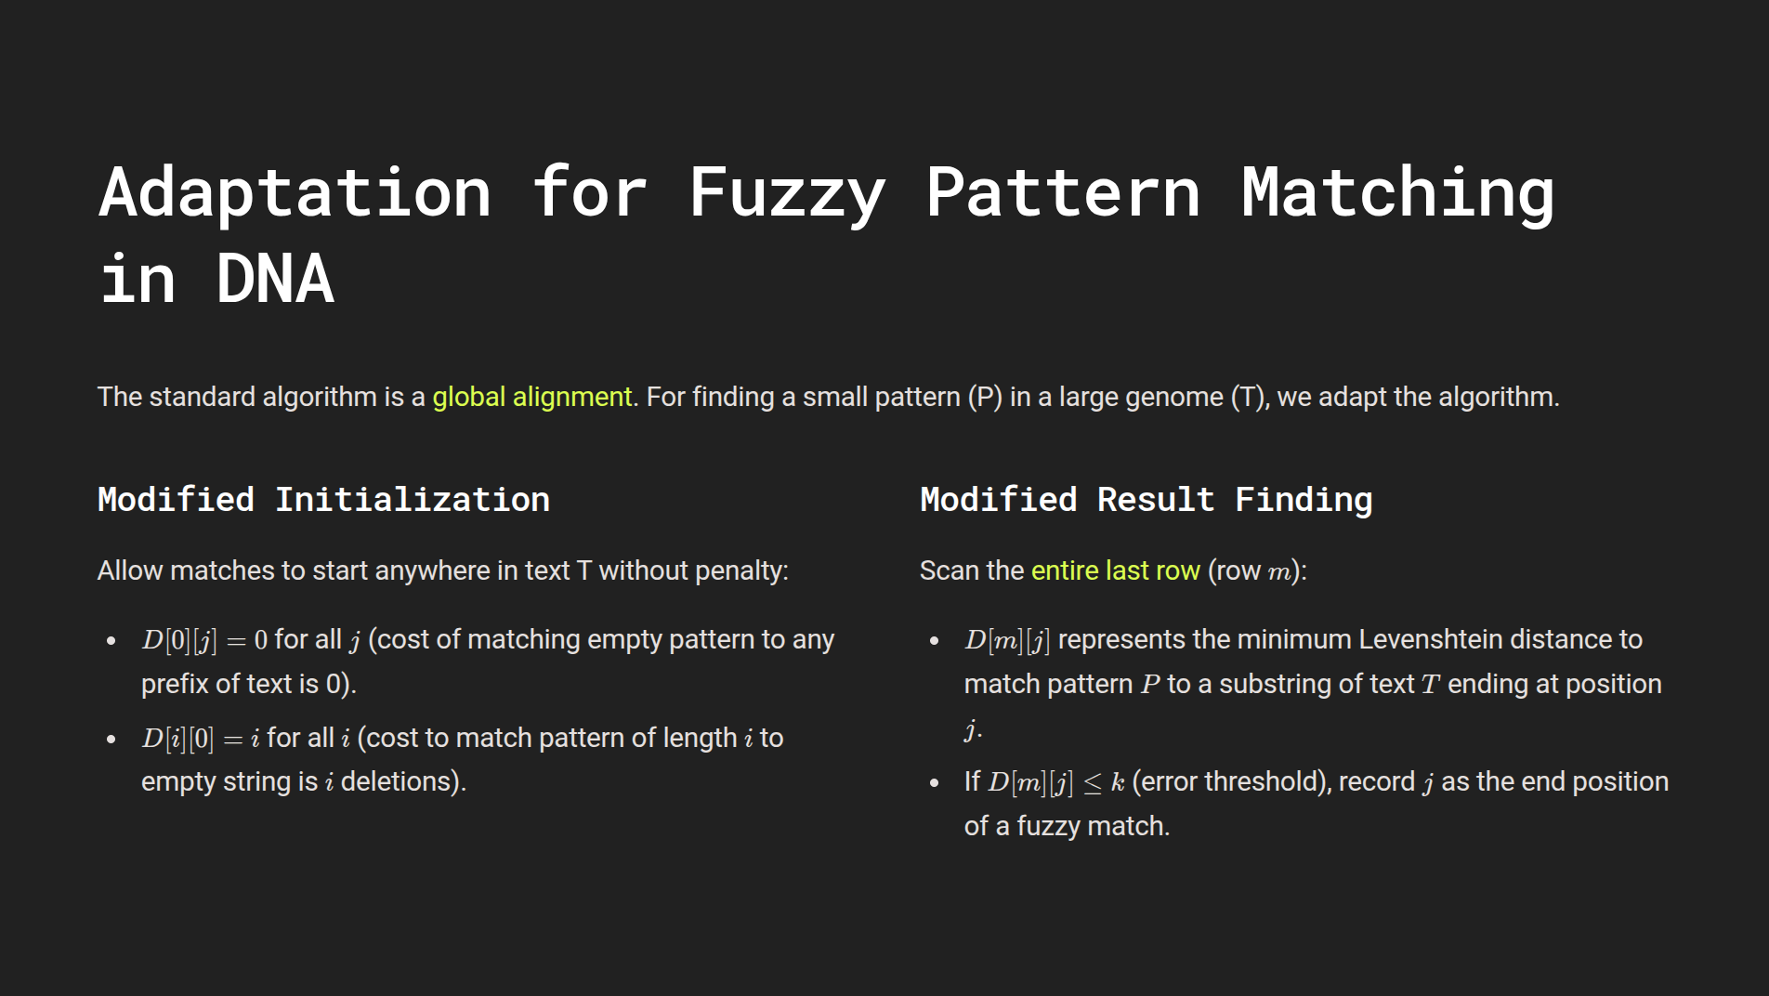

Slide 49
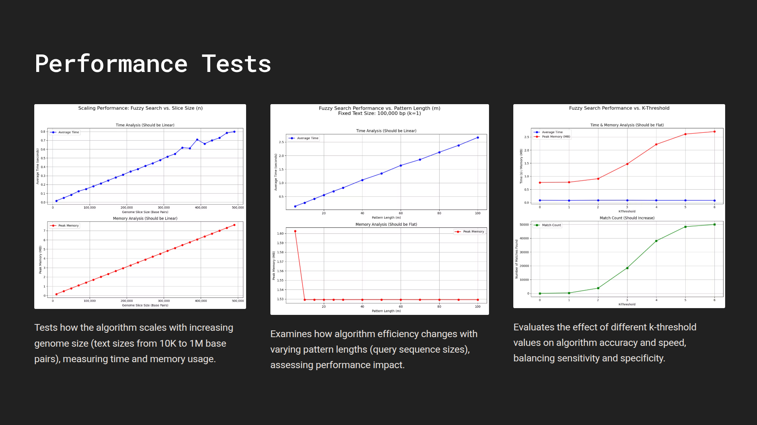

Slide 50
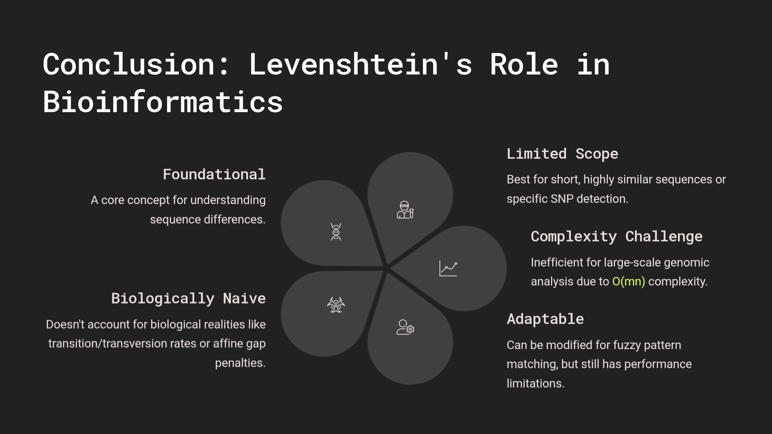

Slide 51
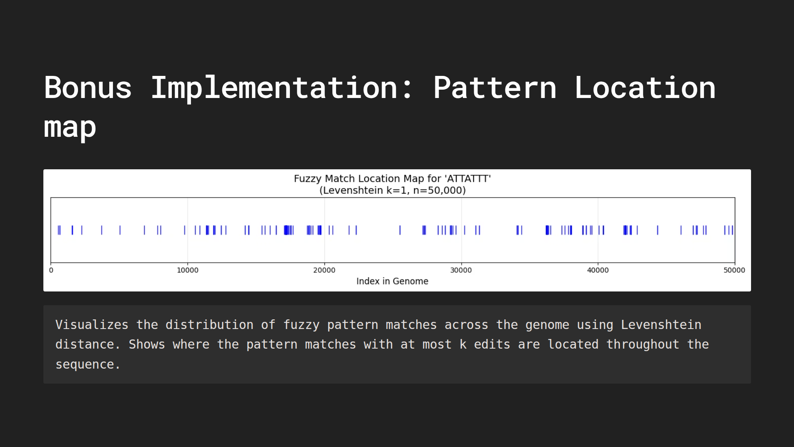

Slide 52
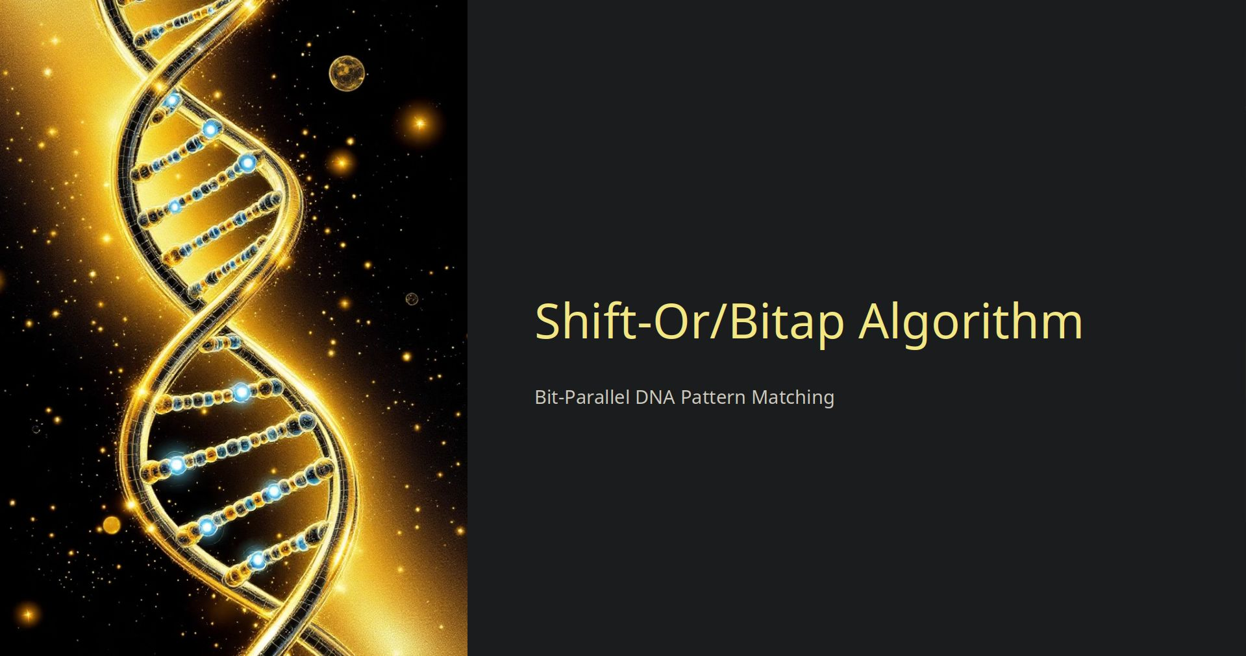

Slide 53
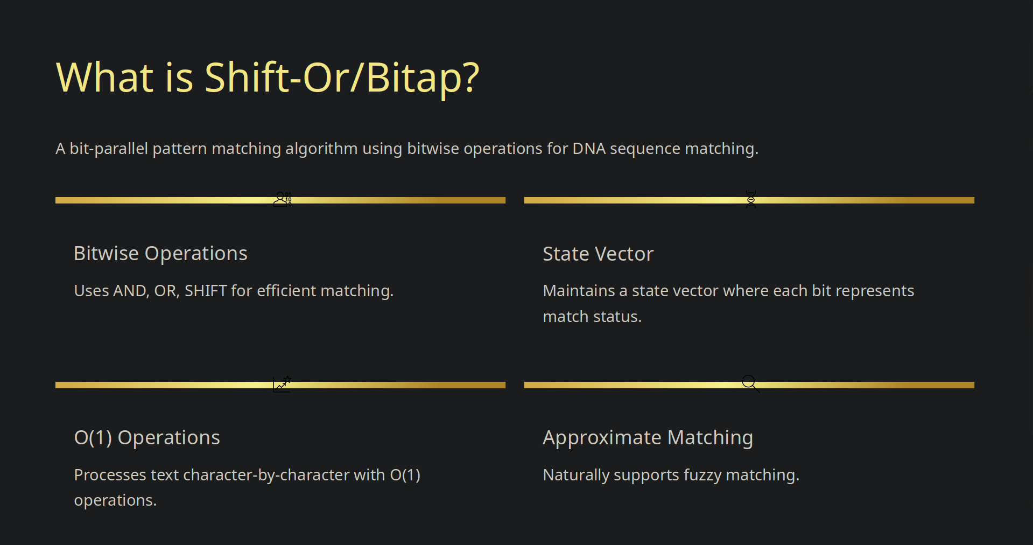

Slide 54
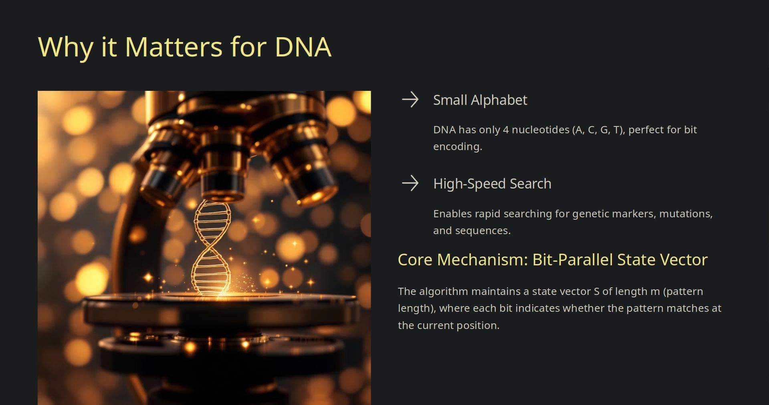

Slide 55
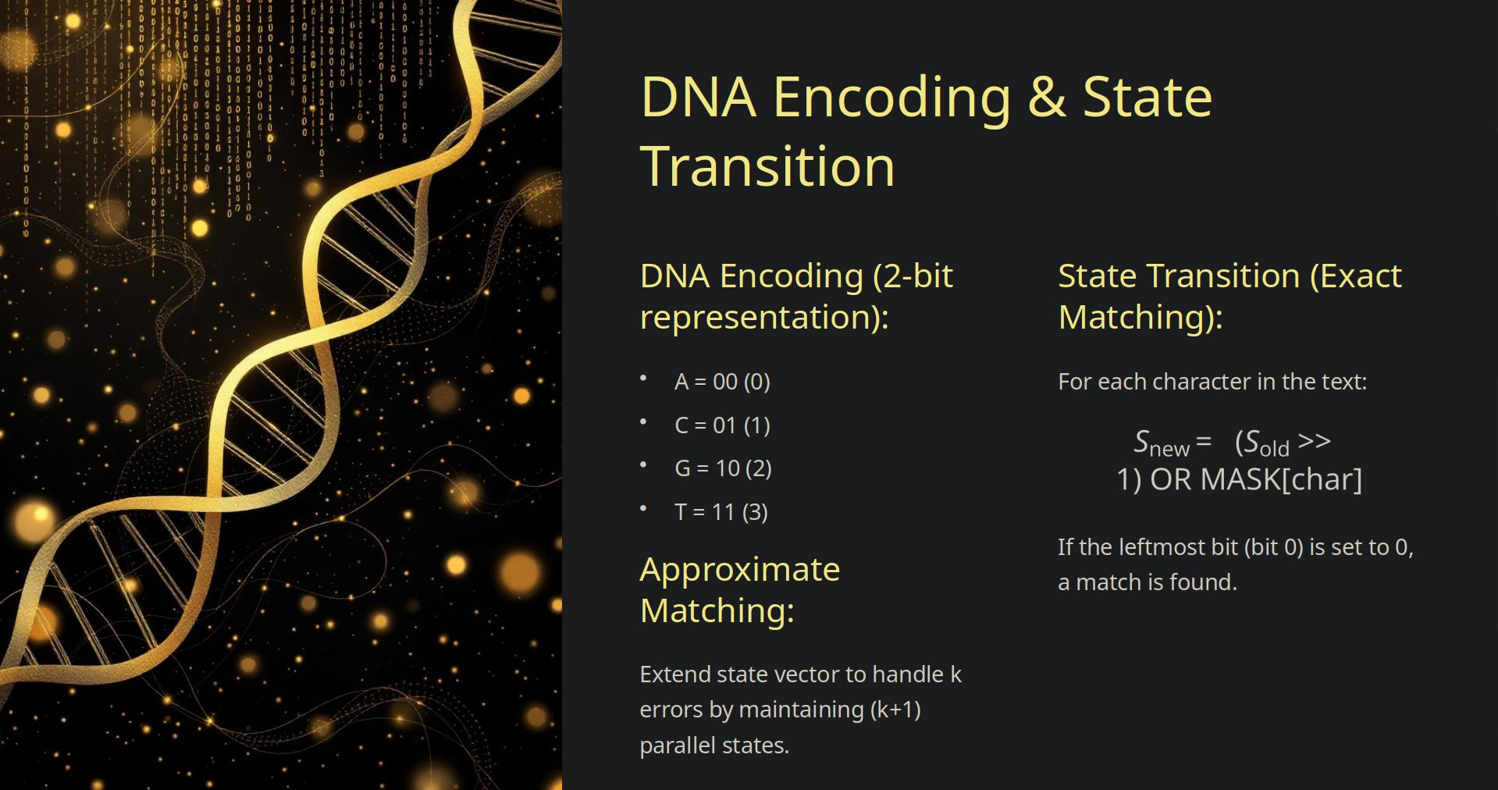

Slide 56
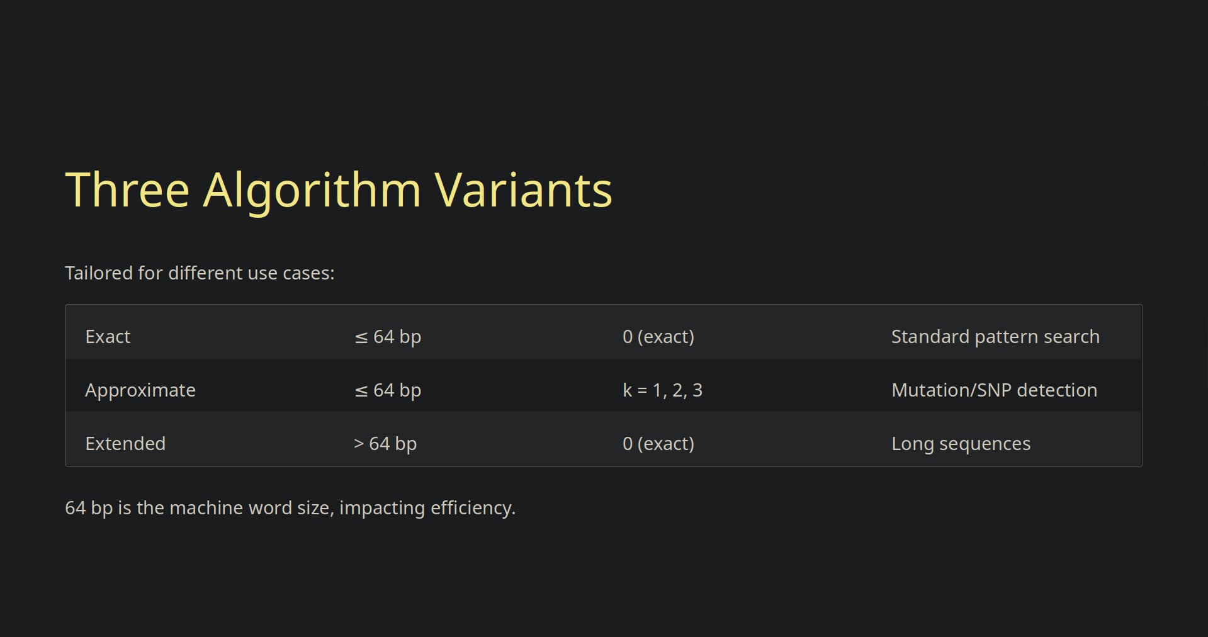

Slide 57
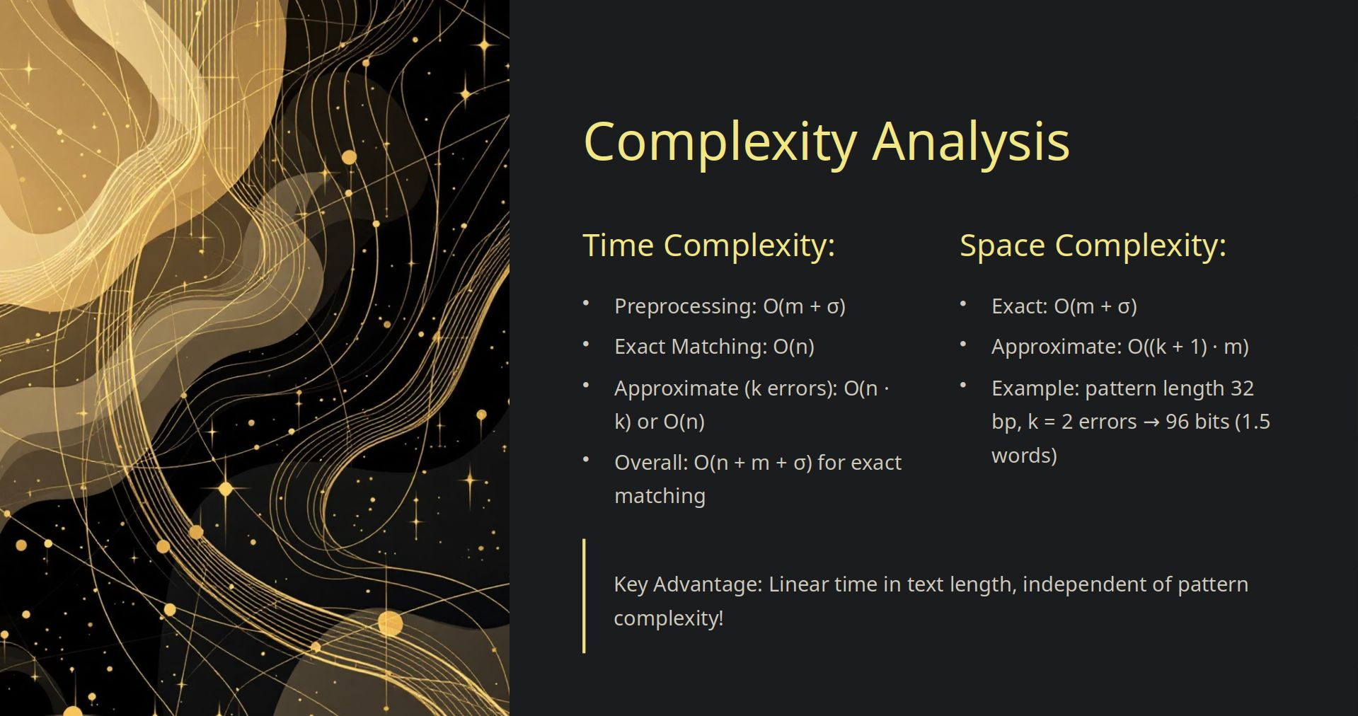

Slide 58
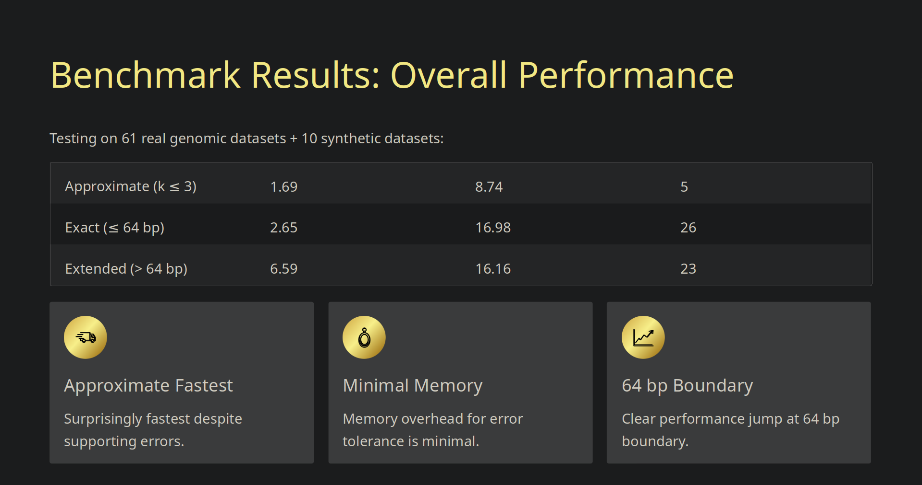

Slide 59
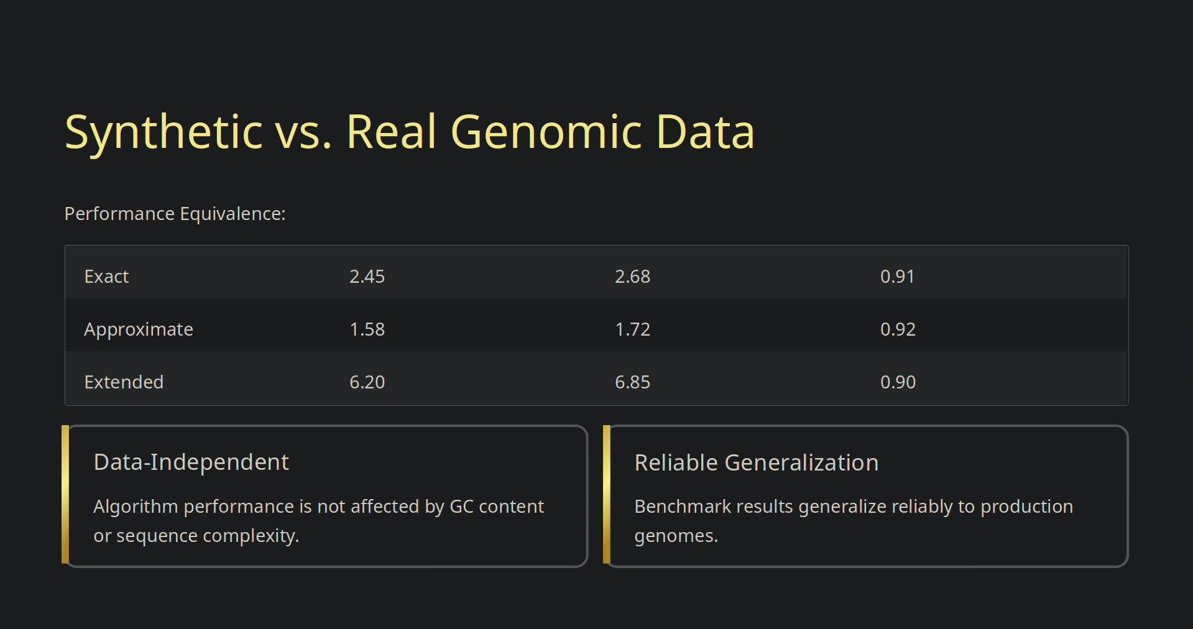

Slide 60
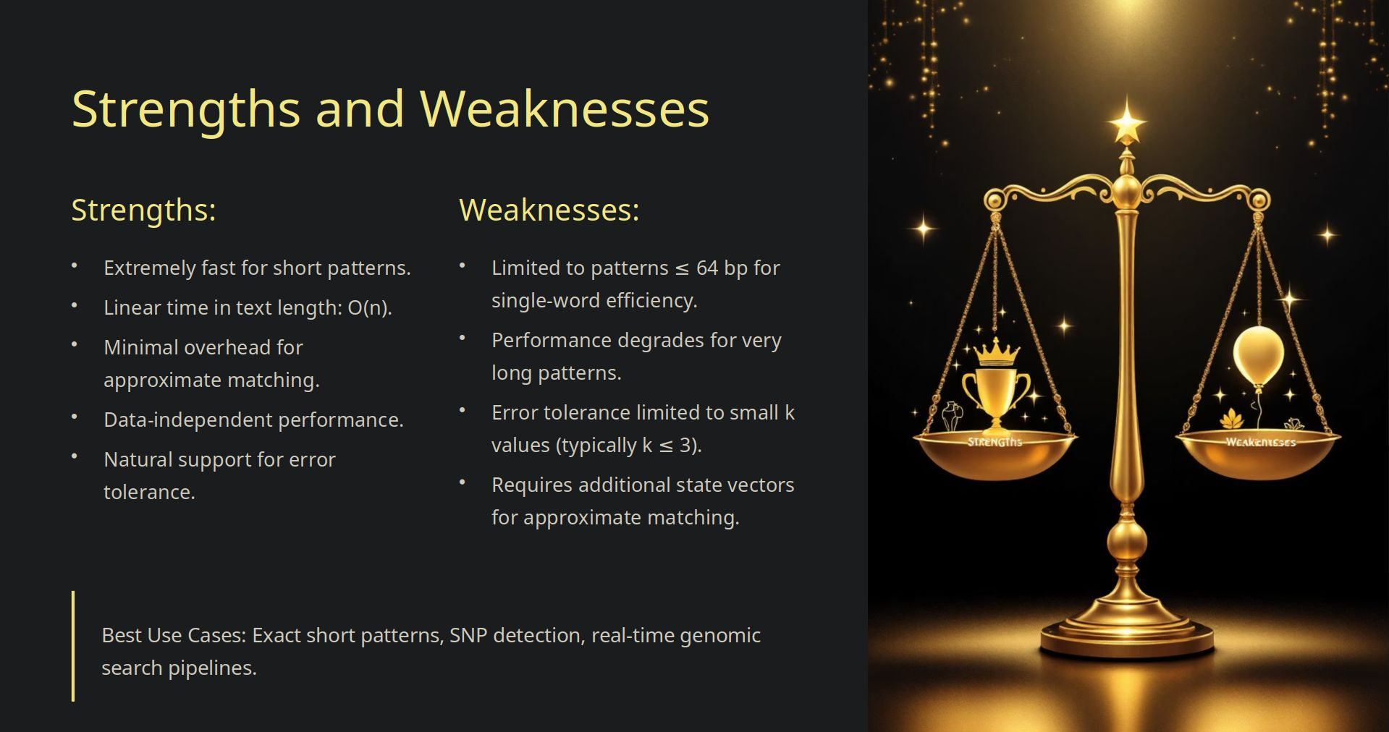

Slide 61
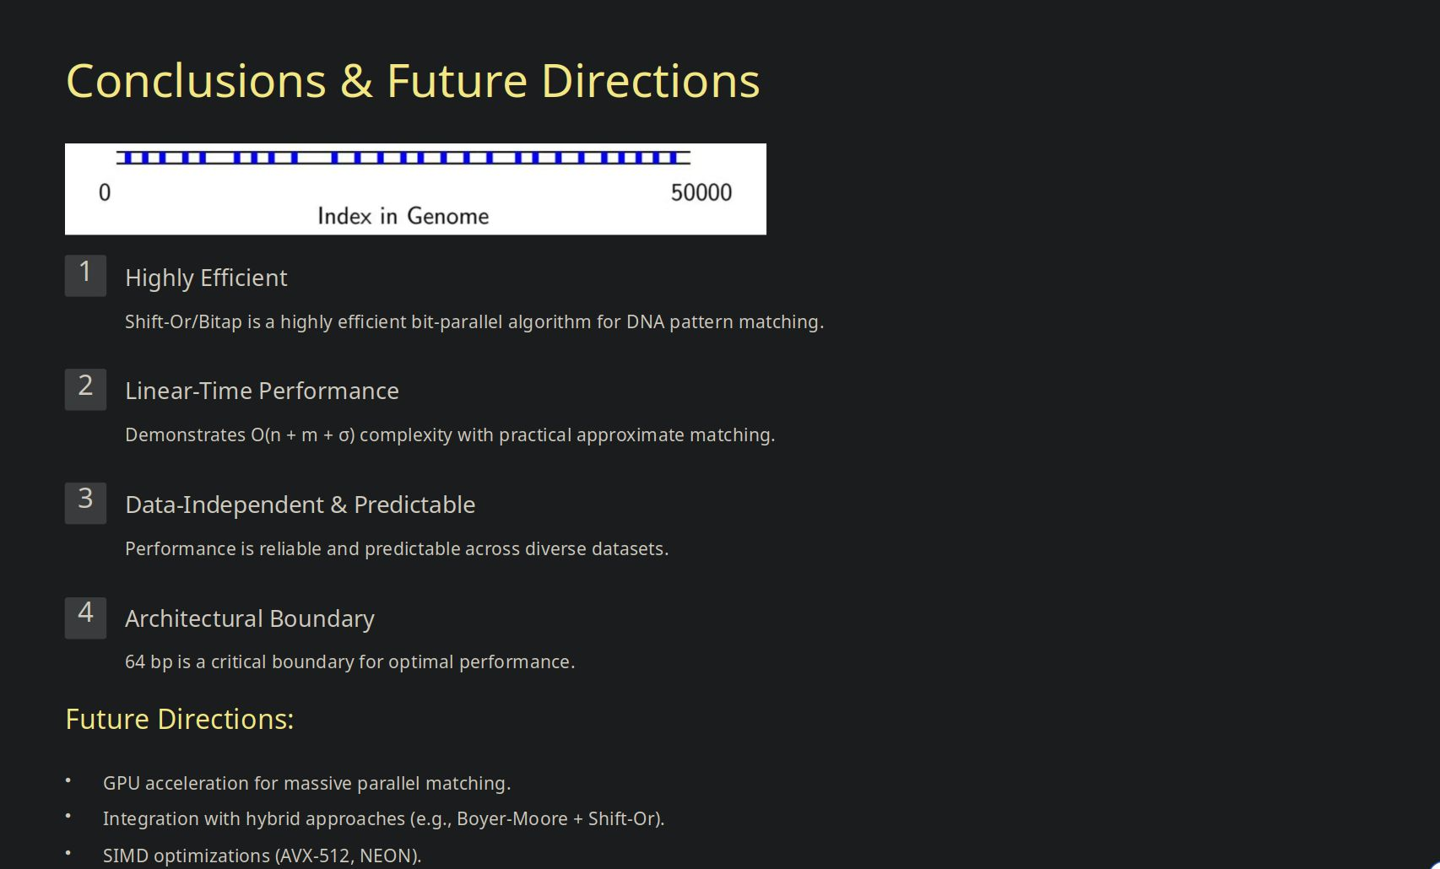

Slide 62
Cross Algorithm Benchmarks

Slide 63
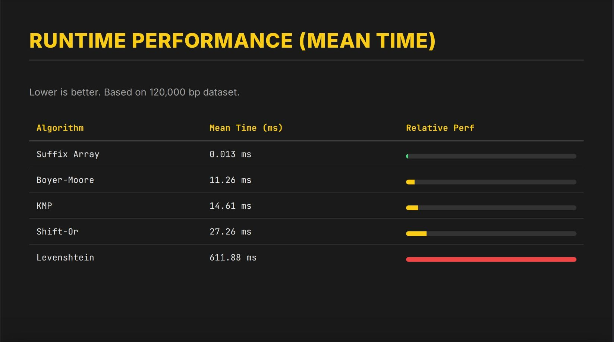

Slide 64
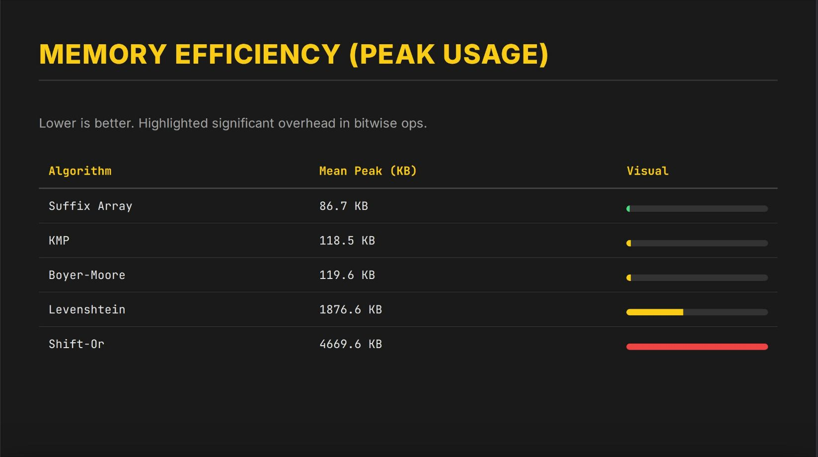

Slide 65


Slide 66


Slide 67



Slide 68


Slide 69


Slide 70


Slide 71


Slide 72



Slide 73


Slide 74


BOYER+SHIFT-OR HYBRID MATCHER
Dynamic Switching for Optimized Text Search

Slide 75


MOTIVATION & ARCHITECTURE
STATE 1: THE CRUISER
STATE 2: THE INVESTIGATOR
Algorithm: Boyer-Moore
Algorithm: Shift-Or
Excels at skipping large portions of text when mismatches occur early. It acts as the "Cruiser," moving rapidly through dissimilar data but may perform redundant comparisons in high-similarity regions.
Uses bit-parallel matching to efficiently process every character. It acts as the "Investigator," perfect for regions with high partial similarity, though it lacks the ability to skip text positions.

Slide 76


COMBINING STRENGTHS
The hybrid approach dynamically leverages the complementary strengths of both algorithms to optimize performance across varying text characteristics.
Adaptive Switching Moves between high-speed skipping and detailed bit-parallel processing.
Context Awareness Detects local text similarity to trigger the appropriate state.

Slide 77




PARTIAL MATCH DENSITY (PMD)
THE SWITCHING MECHANISM
When Boyer-Moore encounters a mismatch, it calculates PMD by counting consecutive matches from the pattern's right end.
Threshold ( ): If , the algorithm switches to Shift-Or (State 2), as high density indicates the text is "close" to matching.

Slide 78



IMPLEMENTATION VARIANTS
EXACT MATCHING HYBRID
APPROXIMATE MATCHING HYBRID
Both states perform exact matching. The switch to Shift-Or in high-PMD regions provides verification and catches matches that Boyer-Moore's skip heuristics might delay detecting.
Boyer-Moore handles exact matching (State 1), while Shift-Or performs approximate matching with k allowed errors (State 2). This enables fast traversal of dissimilar regions while detecting fuzzy matches.

Slide 79

EFFICIENCY REDEFINED
By implementing a Structure-Aware Hybrid Model, we bridge the gap between speed and accuracy.
This dynamic approach ensures that whether the text is sparse or dense with potential matches, the algorithm operates at peak efficiency, utilizing the best tool for the immediate context.

